Slide 1




Basic Electrical Skills
Theory Presentation
Funded by the European Union. Views and opinions expresse are however those of the author(s) only and do not necessarily reflect those of the European Union or the European Education and Culture Executive Agency (EACEA). Neither the European Union nor EACEA can be held responsible for them.
This document has been created as part of the wider T-shore project, co-funded through the European Union’s ERASMUS+ programme.

Slide 2



Document Information
Document Author Partners: Skive College
Version no. | Date | Description of changes | Prepared by
01 | 11.12.2024 | New presentation created | Jens Høffner, Heidi Katrine Rosenberg
Copyright
This document was developed under the T-shore project, coordinated by Skilliant. © 2024 – Skilliant. All rights reserved. Licensed to the European Education and Culture Executive Agency (EACEA) under conditions.

Slide 3
Aims and Objectives of Intro to Basic Electrical skills
Main Aim
The purpose of this theory material is to provide an introduction to calculations on electrical DC circuits, as well as perform measurements of current, voltage and resistance with a multimeter. Build minor basic relay technical connections and knowledge of logic circuits in connection with relay and PLC controls, and use the mechanical limit switches and inductive sensors found on a control.

Slide 4

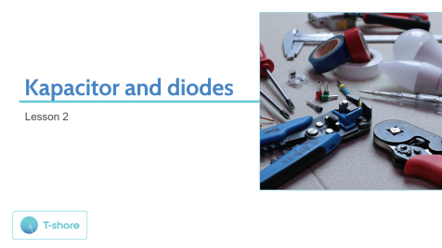
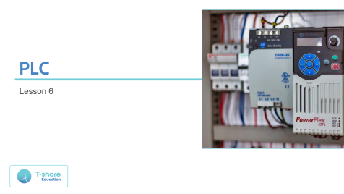
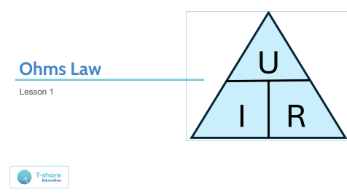
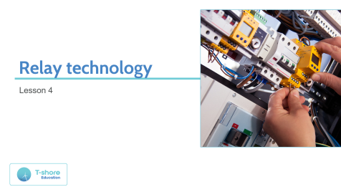
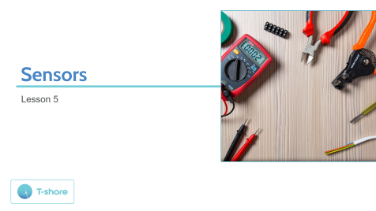
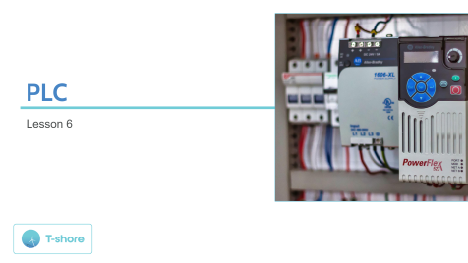

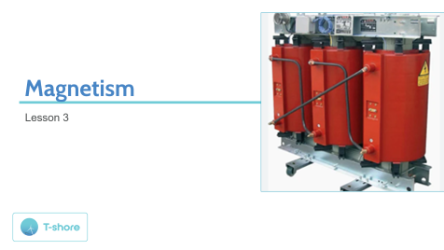
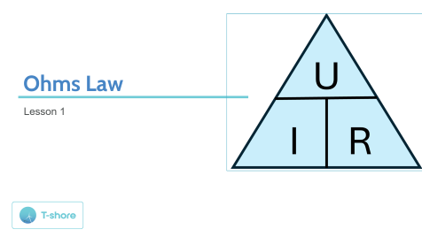



Content

Slide 5
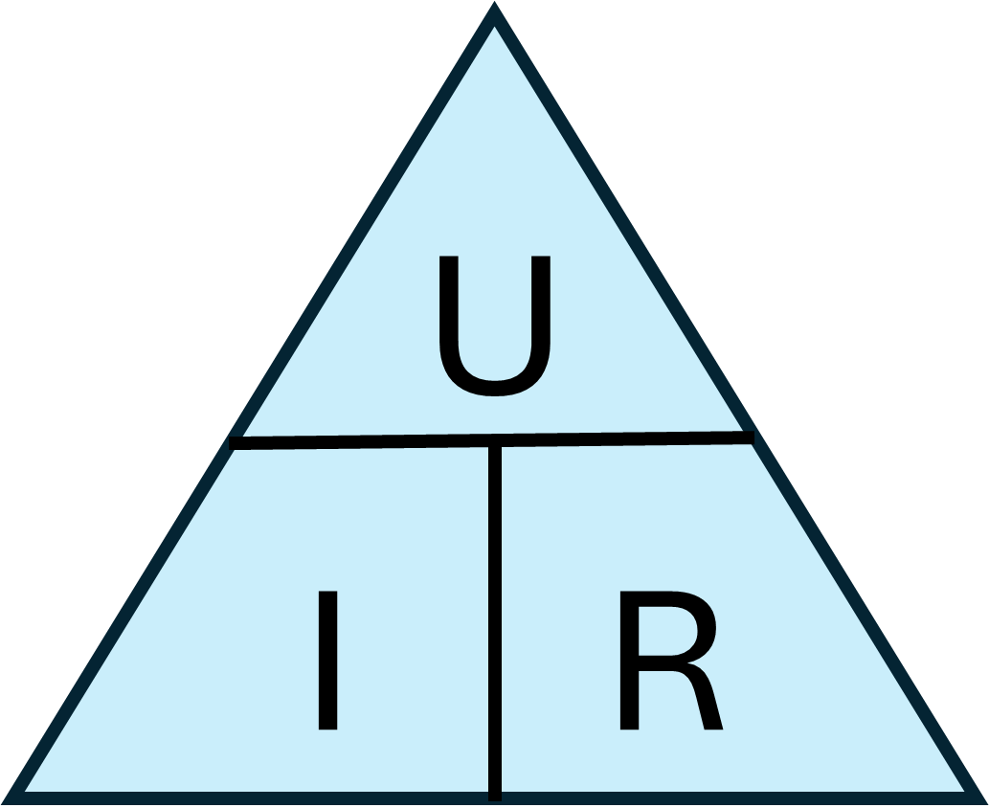
Ohms Law
Lesson 1

Slide 6
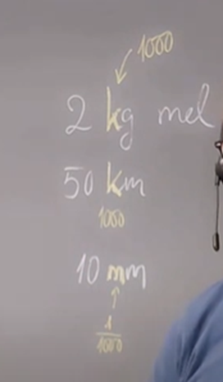
What is prefix?
Prefixes we use when we have a very large or small number. So when we need to convert units, we use prefix, to put in front of a unit.
We know it from, for example, 2 kg of flour or. 40 km, where the prefix here is "kilo" and means 1000 times more than our basic unit meter (m).
Or from, for example, 60 mm, where the prefix is "mili" and means 1/1000 less than our basic unit meter (m).
Wind turbines: E.g. one of 2 MW. Here the prefix is "Mega" and means 1000000 (million) times more than our base unit Watts (W).
- 2 MW is the same as 2000000 W.

Slide 7
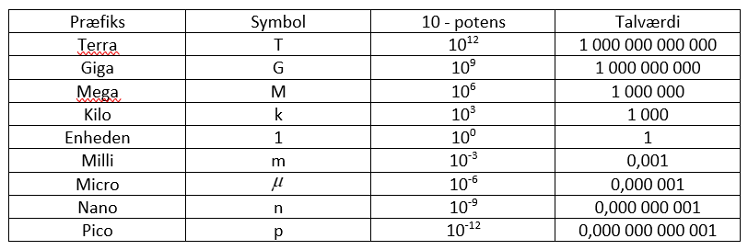
Prefix's table

Slide 8
Prefix
If we go up a notch, the next prefix is 1000 times larger. 1000 (thousand). Here the prefix kilo (k) is which is 10³ (10x10x10)
If we go up another thank, the next prefix is 1000 times bigger. 1000000 (million). Here the prefix is Mega (M), which is 10⁶ (10x10x10x10x10xx10x10)
If we go up another thank, the next prefix is 1000 times bigger. 1000000000 (billion) Here is the prefix Giga (G) which is 10⁹ (10x10x10x10x10x10x10x10x10x10)
If we go up another thank, the next prefix is 1000 times bigger. 1000000000000 (billion). Here the prefix is Tera (T) which is 10¹² (10x10x10x10x10x10x10x10x10x10x10x10x10)

Slide 9
Prefix
If we go down a notch, the next prefix is 1/1000 times smaller (thousand). Here is the prefix mili (m), which is 10⁻³ (10/10/10)
If we go down another thanks, the next prefix is 1/1000000 times smaller (million). Here is the prefix micro (μ) which is 10⁻⁶ (10/10/10/10/10/10)
If we go down another thanks, the next prefix is 1/10000000000 times smaller (billion). Here the prefix is nano(n), which is 10⁻⁹ (10/10/10/10/10/10/10/10/10/10)
If we go down another thanks, the next prefix is 1/100000000000000 times smaller (trillion). Here is the prefix pico(p), which is 10⁻¹² (10/10/10/10/10/10/10/10/10/10/10/10/10)

Slide 10
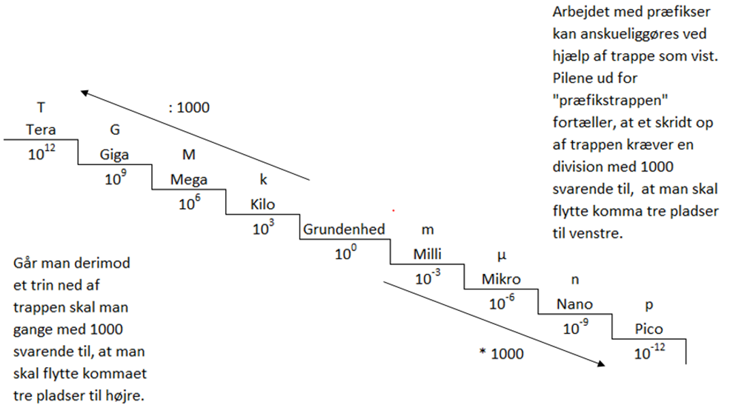
Prefix ladder

Slide 11
What do we use Prefixes for?
We use this for when we calculate in electricity.
Numbers must always be inserted in the basic unit, in a formula.
Then we have stated a unit called 2 kΩ, it must be converted to 2000 Ω before we start calculating.
We will get to that when we are about to calculate in orbit!.
Example:
Stated that we have 5 kg (kilo) of sugar that must be added together with 500000 mg of sugar.
Then we must first convert it to pure units (grams).
5 kg is converted to (5 * 103) = 5000g and 500000 mg is converted to (500000 * 10-3) = 500g.
So, it will be a total of 5500 g (grams).

Slide 12
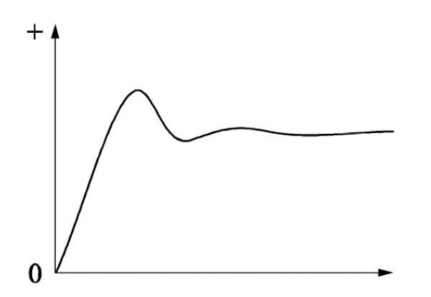
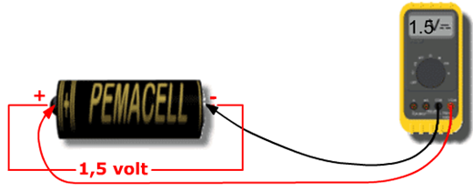
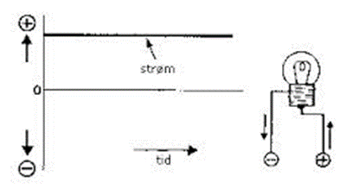
Direct current (DC)
Direct voltage is an electric current which runs continuously in the same direction through the wire, but it does not have to have constant strength.
One terminal is always + and the other always -
If a light bulb is connected to a battery, a current will run from one pole, through the bulb, to the other pole.

Slide 13
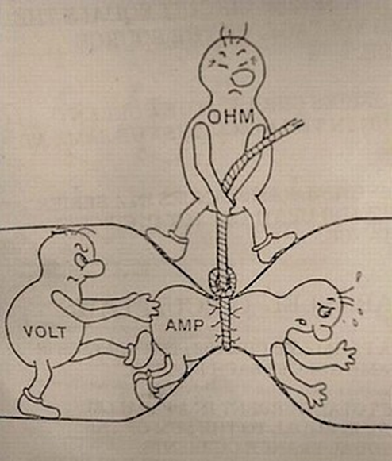
Voltage (Voltage difference)
Between an electricity source and two connection terminals, there is a certain voltage difference. If an electrical utility is connected between such two terminals, a current will pass through the circuit lip.
The current strength is limited by the electrical resistance in the circuit.
The device 1 volt can be derived as the voltage needed to send a current of 1 ampere through a 1 ohm resistor.

Slide 14

Voltage (Voltage difference)
When talking about voltage, you have to remember that it is a difference, i.e. that it is the difference between two poles.
On a 1.5 V battery, 1.5 V is measured if I put a plug on both + pole and pole.
If I put both props on + or – the voltage will be 0 V, as there is now no voltage difference between the props.
Indications:
Denomination Volt
Abbreviation V
Formal Letter U

Slide 15
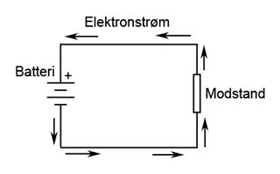
Current
An electric current, or electron current, is a movement of electrons in a conductive material, e.g. copper or aluminium.
Conductive materials are when dug up from the ground filled with electrons, so these are not something that is replenished from the voltage source.
The voltage is the force that makes the electrons move, but the movement itself is called the current.

Slide 16
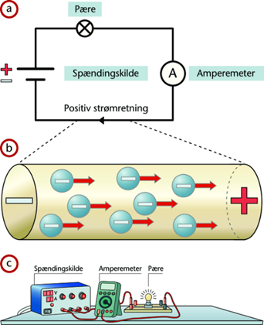
Current
Since the electrons have negative charge, they will move in the direction of the positive clamp on the voltage source that is supplied at the same time, as many new electrons from the negative clamp of the voltage source.
Indications:
Denomination Ampere
Abbreviation A
Formal letter I

Slide 17
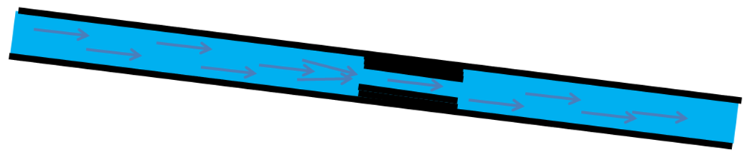
Resistance
Resistance, is the resistance a material provides against electrons running through it, resistance is measured in Ohms and the formula sign R.
The resistance tells us something about how difficult it is for the electrons to pass through the material.
A resistor has a resistance of 1 Ohm if a current of 1 Ampere runs through it when a voltage of 1 Volt is applied.
From this, Ohm's law is obtained: U = I ⋅ R

Slide 18
Resistance
Substances with a very small resistance are called conductors, e.g. Silver, aluminum and copper. Copper and aluminum are used for electrical wiring.
Silver is used for securing wire and coating on contact surfaces.
Substances with such great resistance that the current can hardly pass through are called insulators.
Examples of such are plastic, porcelain, rubber, paper and oil.
Indications:
Denomination ohm
Abbreviation Ω
Formal letter R

Slide 19
Ohm's Law
In Ohm's law, the following two equivalent statements apply: (equivalent = true statements)
The resistance is independent of the voltage.
The relationship between voltage and amperage is linear.
In symbols, this is written as follows:
U = I x R, i.e. voltage is equal to current times resistance.

Slide 20
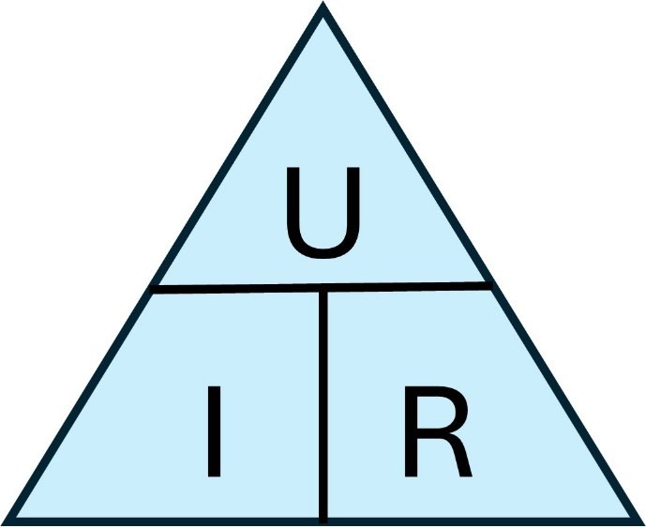
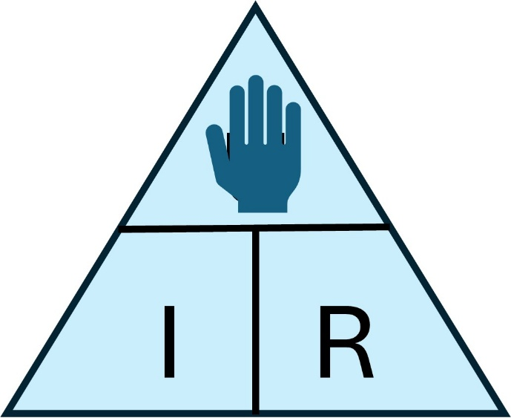
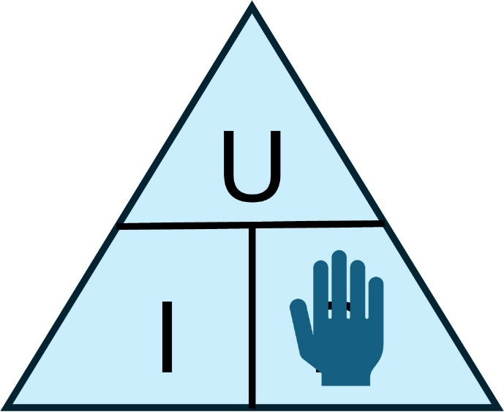
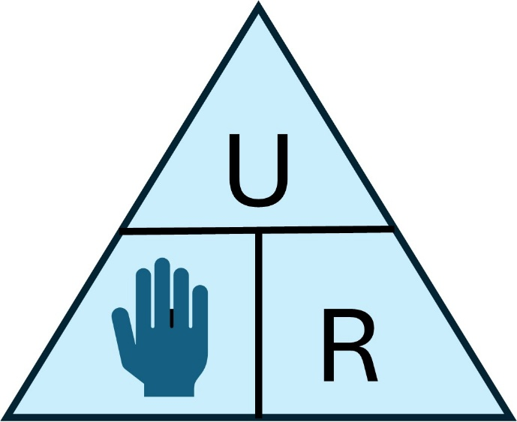
Ohm's Law
Ohm's law
Calculate voltage
Calculate voltage
Calculate resistance
Calculate current

Slide 21
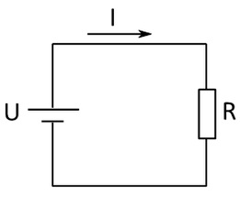
Ohm's Law
Ohm's law describes that between voltage, current, and resistance there is a dependency that means that you cannot change one of the parts without at least one of the other parts also being changed.
This cohesion between the quantities U, I, and R is expressed by the following formula, called Ohm's law:
Voltage = current * resistance:
U = I * R [V]
Ohm's Law can also be paraphrased to:
I = U / R [A]
R = U / I [𝛀]

Slide 22
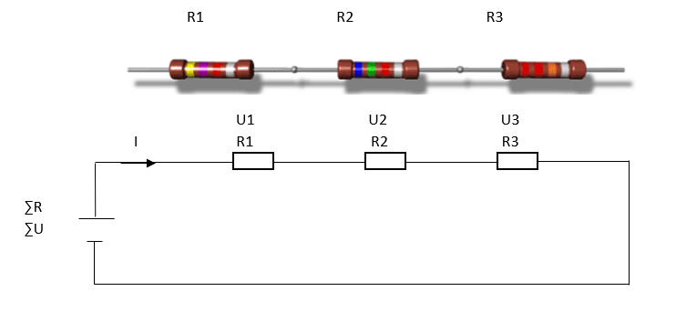
Series connection
In series connections, the resistors are placed one after the other like beads on a string.

Slide 23
Series connection
Current and resistance
The same current must run through all the resistors to get back to the supply. It must therefore be possible to deduce that the current is the same in a series connection.
The total resistance in a series connection is found by adding all the resistors in the circuit together.
ƩR = R1 + R2 + R3 etc.

Slide 24
Series connection
Voltage
When a current passes through a resistor, a voltage drop will occur across the resistor.
Since U = I × R, the greatest voltage drop will be above the greatest resistance, and the sum of the 3 voltage drops U1, U2 and U3 is equal to the supply voltage.
This can be deduced from Kirchhoff's 2 law.
The sum of the partial voltage drops is equal to the applied voltage.
ƩU = U1 + U2 + U3

Slide 25
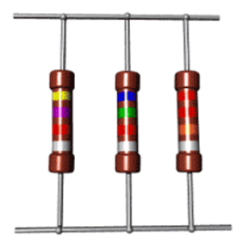
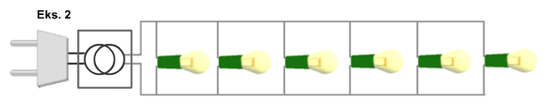
Parallel connection
In parallel connection, the resistors are placed as on a ladder.

Slide 26
Parallel connection
Voltage and current
The voltage drop/voltage is the same across all resistors in a parallel connection.
ƩU = U1 = U2 = U3
The current in a parallel connection will divide over each resistor, and run back to the starting point
ƩI = I1 + I2 + I3

Slide 27
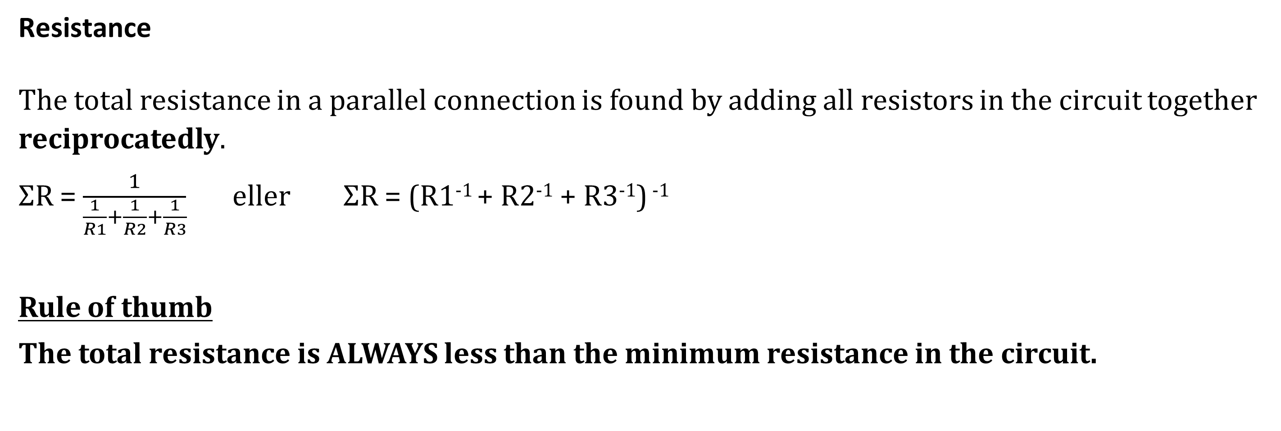
Parallel connection
Resistance
The total resistance in a parallel connection is found by adding all resistors in the circuit together reciprocatedly.
ƩR = $\frac{1}{\frac{1}{R1}+\frac{1}{R2}+\frac{1}{R3}}$ eller ƩR = (R1⁻¹ + R2⁻¹ + R3⁻¹) ⁻¹
Rule of thumb
The total resistance is ALWAYS less than the minimum resistance in the circuit.

Slide 28
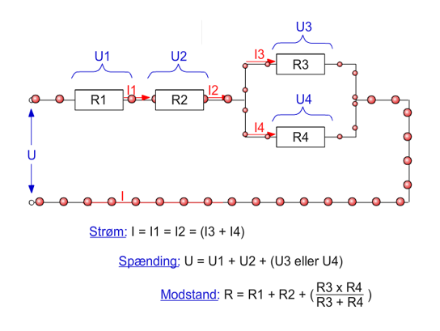
Mixed connection
Now it gets a little more complicated!
2 important rules to remember for mixed compounds:
1. EVERY TIME THERE IS A SERIES OF RESISTORS, THERE IS A VOLTAGE DROP
2. EVERY TIME THERE IS A PARALLEL CONNECTION, THERE IS A POWER SHARING.

Slide 29
Parallel connection
Mixed connections are a circuit that includes both series and parallel connections.
In such cases, each small part must be calculated separately, drawing new and simpler diagrams all the time.
Thus, they try to make the circuit more and more simple, so that in the end you end up with a few series-connected resistors.
The new diagrams you sketch are called equivalent diagrams as they are equivalent (=meaning) to the previous ones.
On this one cannot establish simple and unambiguous rules, only say that ohm's law applies and that the basic rules regarding series and parallel couplings apply.
YOU SHOULD ALWAYS START BY MERGING RESISTORS WHERE THE VOLTAGE OR CURRENT IS THE SAME.

Slide 30
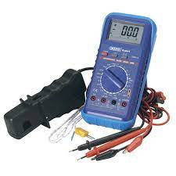
Measurements
Any measuring instrument must be designed so that it is "like a fly on a wall", i.e. it does not interfere with the circuit on which it is measured.
It is important that you know your measuring instrument and get it set correctly before measuring.
And then it is also important that you have an idea of what the measuring device should show when measuring.

Slide 31
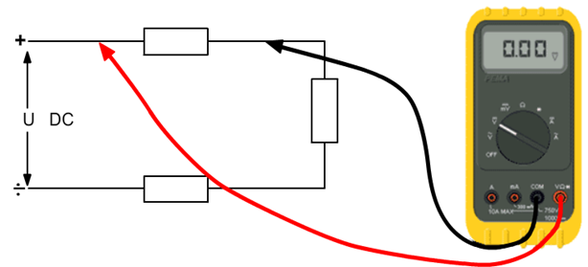
Measurements
Voltage
If the voltmeter is not to interfere in the way it is used, then it should preferably have a LARGE internal resistance, so that it does not "use current" from the circuit being measured.
Due to its large internal resistance, a voltmeter must ALWAYS be mounted parallel to what is being measured.
If inserted in series, it will slow down the flow of the circuit.
The voltmeter should be connected IN PARALLEL.

Slide 32
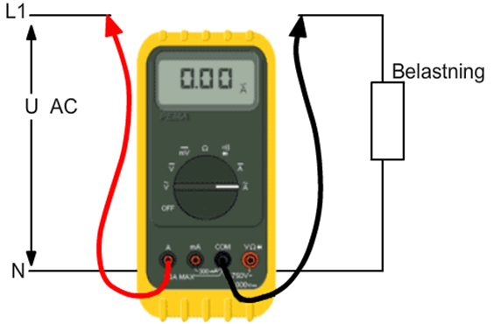
Measurements
Current
If the ammeter is not to interfere in the way it is used, then it must have a very small internal resistance, so that it does not slow down the current in the circuit in which it is measured. Due to its small internal resistance, an ammeter must always be mounted in series in the circuit in which it is measured.
If it is placed in parallel, it will change the resistance of the circuit and thereby also change the circuit.
The ammeter must always be connected in SERIES with the circuit.

Slide 33
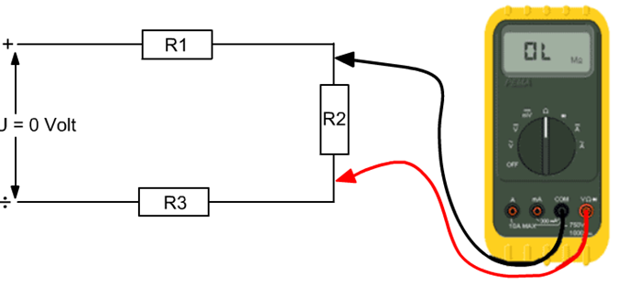
Measurements
Resistance
If the ohmmeter is not to interfere in the way it is used, then it must have a very large internal resistance, so that it does not change the total resistance that is measured.
The resistance is ALWAYS measured without voltage and
one pin of the resistor must be detached from the PCB,
so that only the individual resistor and not the entire
circuit is measured.
The ohmmeter must be connected IN PARALLEL and
measured VOLTAGELESS.

Slide 34
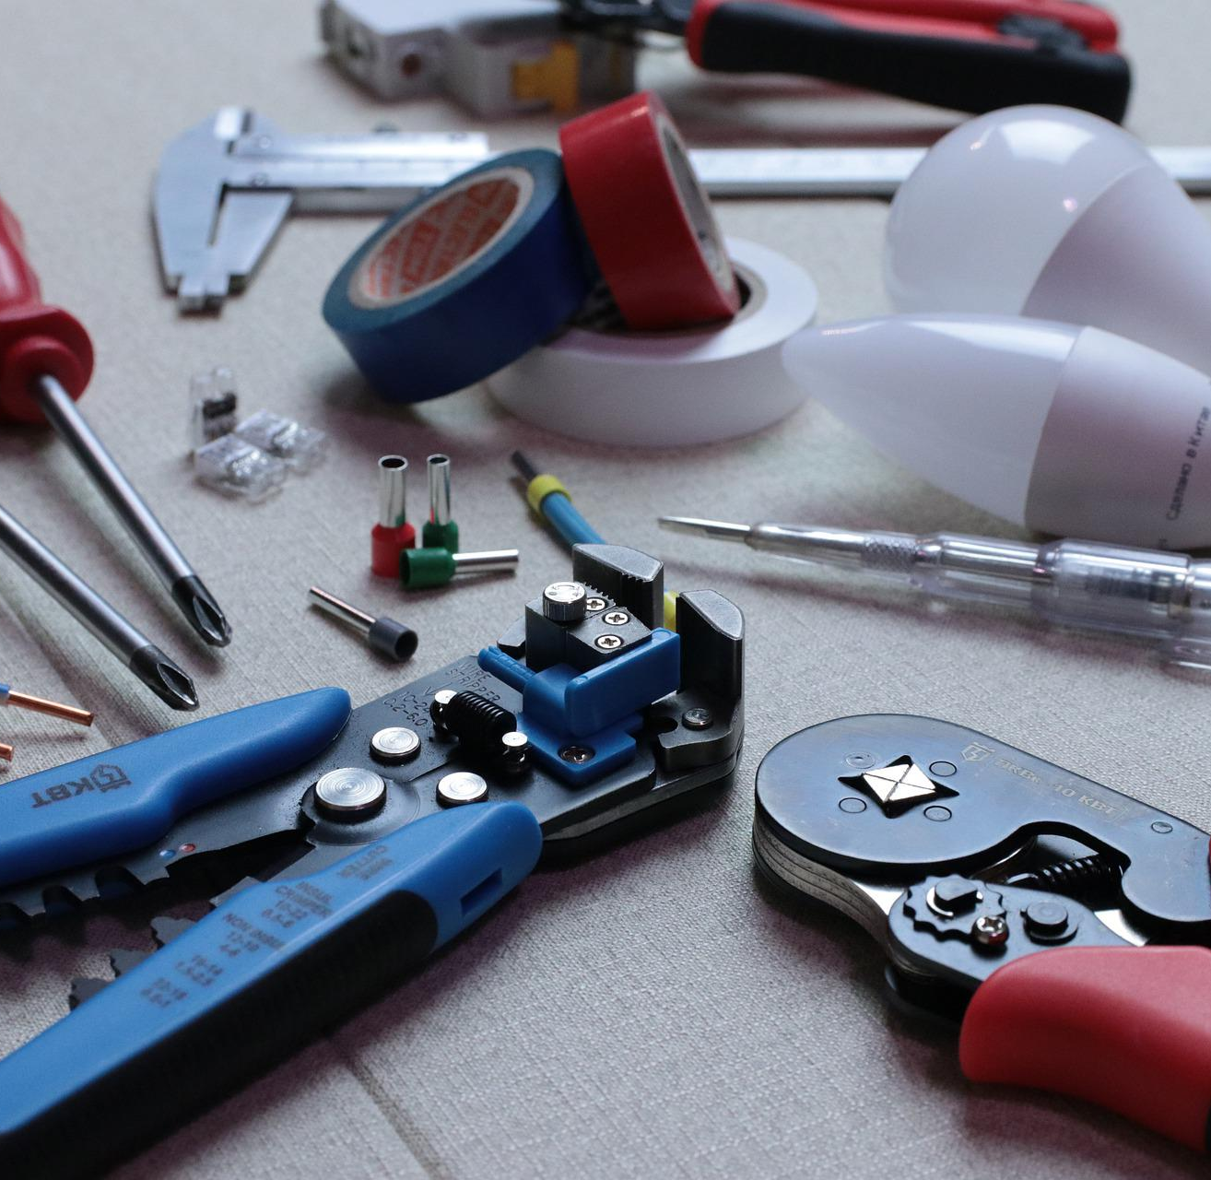
Capacitor and diodes
Lesson 2

Slide 35
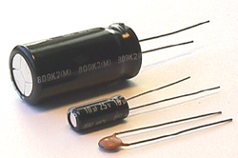


What is a capacitor?
Two parallel conductive plates
The plates are separated from each other by an insulating material called dielectric
The capacitor has two to wires

Slide 36
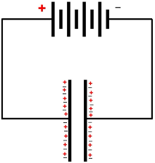
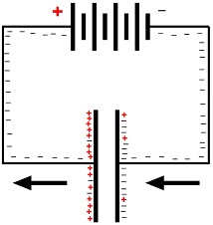
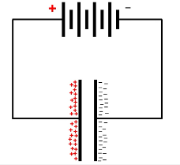
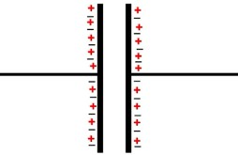
How it works?
The capacitor can store an electrical charge – a portion of electrons
When the power is connected, the capacitor is filled with electrons
The size of the capacitor says something about how many electrons there is room for
The size of the capacitor is called capacity
The capacitor | The capacitor | The capacitor | The capacitor
Voltage-free | connected voltage | charges | fully charged

Slide 37
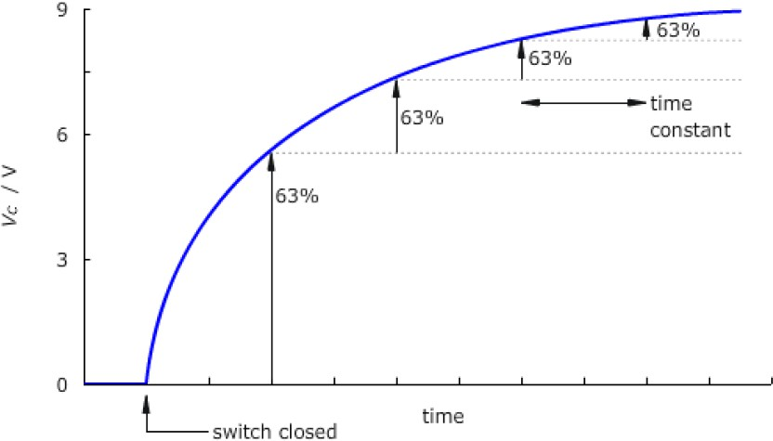
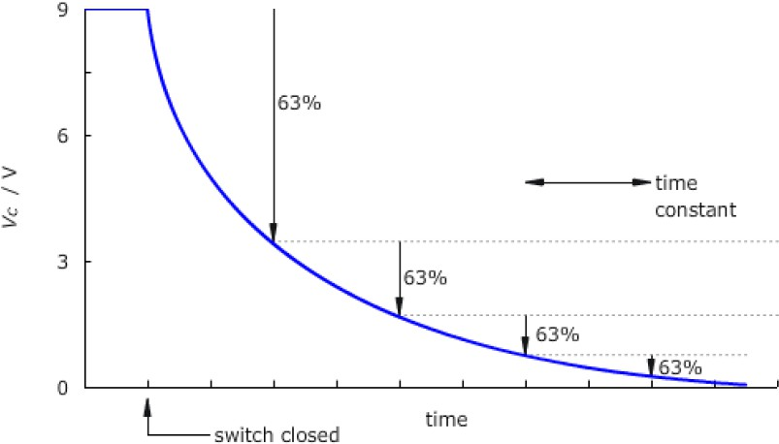
How it works?
Capacitor charging/discharging
A capacitor is in principle never charged, as can be seen from the curve, it is charged for every τ (tau) 63.2%, i.e.
After this, the capacitor is considered fully charged, even though in principle it continues to charge at 63.2% and never gets fully charged.

Slide 38

The names of the capacitor.
Kondensatorens størrelse måles i Farad F
Eks. 10 mF, 5µF, 47nF eller 100pF
Diagramsymbolet er C

Slide 39
Size - Capacitor
Physical size of the capacitor
- With a large plate area, the capacity increases. There may be more electrons on the plates.
The distance between the plates
- The thickness of the insulation material.
- Large distance means less capacity.
Material of insulation
- The insulating material's ability to conduct power lines in relation to air
- Called the dielectric of the capacitor

Slide 40
Formal calculation of capacitor
The alternating current resistance of the capacitor is called reactance
The designation is X_{C} and is measured in ohms
At higher frequency, X_{C} decreases
or
X_{C} = Reactance in ohms
u_{C} = voltage
i_{C} = current
F = frequency in Hz
C = capacity in F

Slide 41
X_{C} as a function of frequency

Slide 42
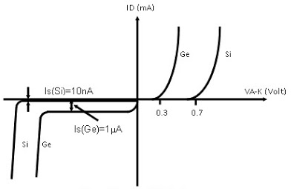
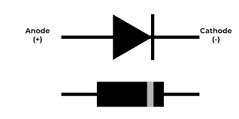
Diode
The diode is a simple, yet very important in any electrical circuit.
The diode is a component that only allows current to pass through one way (the direction of conduction) and provides great resistance in the other direction (the direction of blockage).
The diode is therefore also called a rectifier valve.

Slide 43
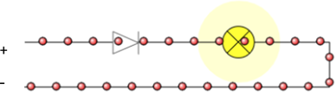

Diode
The diode is a semiconductor that is made from the element silicon (Si) or germanium (Ge). The diode has two connections:
Anode and cathode.
The diode conducts current when the anode is positive and blocks when the anode is negative.

Slide 44
Lock tension and barrier tensioning
The sluice voltage is the minimum value the diode must be pressurised before the current can begin, for germanium diodes the sluice voltage is about 0.3 volts and for silicon diodes about 0.7 volts.
Blocking voltage is the maximum voltage that the diode can block. If this voltage is exceeded, there will be a breakthrough, and the diode will be destroyed.
Silicon diode up to 1000V
Germanium diode up to 100V

Slide 45
Temperature
There is a difference in the temperatures under which the two diode types can work:
The germanium diodes can withstand temperatures up to approx. 80-90°C and the silicon diodes up to approx. 200°C.

Slide 46
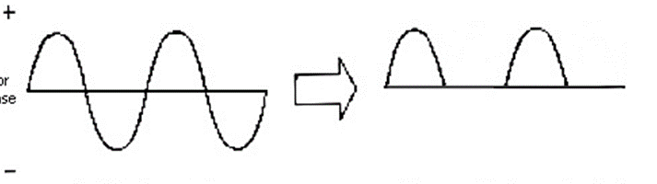
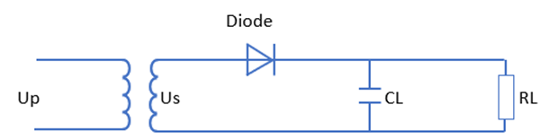
Use of diode
The diode is used for many different purposes, but most often to convert alternating voltage into direct voltage (rectification).
Since current can only flow one way through the diode, current will only flow in one of the two half periods of the alternating voltage. It will not be a very "even" voltage that comes out of it, but it is by definition a direct voltage, and it is called a pulsating DC.

Slide 47
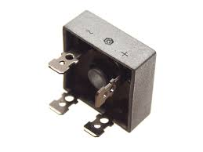
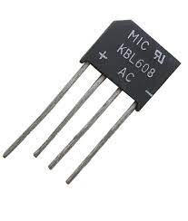
Double one-way
In double rectification, the diodes work together in pairs (2-3) and (1-4).
In the first period, there is a plus in on the diode between 1 and 2 - diode 1 blocks and diode 2 conducts the current through it. The current flows out through the RL and back between diode 1-3. Since the current always wants to return to minus, it must be diode 3 that conducts the current through it.
Then it is diode 1-4 that work together. Plus now comes in between diode 3-4, diode 3 blocks and diode 4 conducts the current through it. The current runs out through RL and back between diode 1-3.

Slide 48
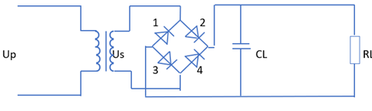
Double one-way

Slide 49
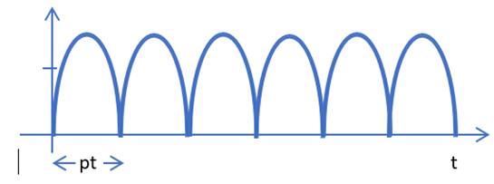
Double one-way
Here is the curve after the diode, as you can see, we use both half periods for double rectification
pt= the period time is equal to 10ms
Double rectification is the most commonly used form of rectification

Slide 50



Smoothing
However, an electric control will not be able to use pulsed direct voltage, which is why it will be necessary to smooth it out.
This smoothing is done with a capacitor. In some cases, smoothing is done by a combination of a coil and a capacitor or by means of resistors and capacitors.
In all three cases, it will be a pure DC voltage that comes from the rectifier.

Slide 51

Magnetism
Lesson 3

Slide 52

Transformation
Enables the transmission of large amounts of energies (currents) at high voltages.
The electrical losses are significantly reduced.
Translates the printed voltage into another.
Right or lower voltage
Primary-
coil
Secon
dary-
coil
Magnetic flux
Iron core

Slide 53

Electromagnet
If the circuit is open, there is chaos in the magnetic circuit.
If the circuit is closed, the coil ensures that a field is created and the magnetic circuit is brought to order.

Slide 54

Saturation of iron
When all the small magnets in the steel bar have been put in order, the saturation point has been reached, i.e. no increase in the magnetic strength of the steel bar is achieved by continuing to iron or increasing the current in the coil of the electromagnet.
force.

Slide 55
An simple transformer
The primary side is connected to a voltage, thereby inducing a magnetic field in the iron core.
This magnetic field passes through the secondary
winding, thereby inducing a voltage in it.
Each winding on the primary and secondary sides is traversed by the same magnetic field.
Therefore, the same tension will also be induced
over each turn.
The voltage on the secondary side will therefore depend on how many turns it has in relation to the primary side.
Fewer turns, lower voltage, more turns, higher
voltage.
Primary-
coil
Secon
dary-
coil
Magnetic flux
Iron core

Slide 56

An simple transformer
N_{p} = Number of windings on the primary side (also calledN₁)
  $$N_{P}=N_{S} x n$$
N_{s} = Number of windings on the secondary side (also calledN₂)
  $$N_{s}=\frac{N_{P}}{n}$$
n = The turnover ratio
  $$n=\frac{N_{1}}{N_{2}}=\frac{U_{1}}{U_{2}}=\frac{I_{2}}{I_{1}}$$
Primary-
coil
Secon
dary-
coil
Magnetic flux
Iron core

Slide 57

An simple transformer
U_{p} = The excitement on the primary side (also calledU₁)
  $U_{P}=\frac{S}{I_{P}}$ eller $U_{P}=U_{S} x n$
U_{s} = The voltage on the secondary side (also calledU₂)
  $U_{s}=\frac{S}{I_{s}}$ eller $U_{s}=\frac{U_{P}}{n}$
I_{p} = Electricity on the primary side (also calledI₁)
  $I_{P}=\frac{S}{U_{P}}$ eller $I_{P}=\frac{I_{S}}{n}$
I_{s} = The power on the secondary side (also calledI₂)
  $I_{s}=\frac{S}{U_{s}}$ eller $I_{S}=I_{P} x n$
Primary-
coil
Secon
dary-
coil
Magnetic flux
Iron core

Slide 58

An simple transformer
V/N = Former pr. vikling (is the same on both sides)
  $$V/N=\frac{Up}{Np}$$
N/V = Viklinger pr. volt (is the same on both sides)
  $$N/V=\frac{Np}{Up}$$
S = Transformer size in VA or kVA
  $$S=U∗I$$
P = The power output in W
  $$P=U∗I∗cosφ$$
Primary-
coil
Secon
dary-
coil
Magnetic flux
Iron core

Slide 59

An simple transformer

Slide 60

Relay technology
Lesson 4

Slide 61

What is relay technology?
There is a difference between main power and control
Relays are a low-practical solution for control, but work
PLCs are a more complex solution but have become a low-cost alternative.

Slide 62


Relay
The relay consists of two main components.
The coil that activates the contact set.
The switch set that either opens or closes.

Slide 63

Relay
It could look like this.
This is a plug pin relay.
NO
Ben
Spole
ben
COM
NC Ben

Slide 64



Standard Relay
Killed by large currents
Main contacts
Help contacts

Slide 65








Contacts plating and numbering
Head Contact Set
End contact set
Breaking contact set
Help contact set
Early quit
Sen bryde

Slide 66

Drift former
Errors in
book
AC3
Contactor type 1 is defective after a large short circuit
Type 2 contactor should still work after a large short circuit

Slide 67



Thermo relay

Slide 68



Thermo relay
Cold
Operation hot
Disconnected

Slide 69


Magnet operated motor protection - engine start
GL type that is still used

Slide 70


Time relay
Delayed attraction
Time starts when the time circuit gets tension
After the measured time, the contact set changes
time

Slide 71


Time relay
Delayed drop-out rate
Time starts when the voltage to the time circuit is broken
After the measured time, the contact set changes
time

Slide 72


Push buttons and switches

Slide 73


Lamp and lamp pressure

Slide 74

Emergency stop
This is not an emergency stop, but a toad tap

Slide 75
Wire Colors
Black : AC and DC Power Circuits
Red : AC Control Circuits
Blue : DC Control Circuits
Orange : Control circuits with foreign control voltage
Yellow/Green : Protective conductor
Light blue : Zero conductor

Slide 76

Control Transformer
Power Circuit
Transformer short-circuit protection
Control circle
transformer overload protection

Slide 77

One-line chart
The one-line chart is not the most commonly used but is often found on smaller machines.
The inclined roasts indicate the leader number

Slide 78

More lines chart
The most commonly used drawing style for the main power circuit

Slide 79


Controlling the circuit chart
Contact position
The individual contacts In a key schema, the individual contacts are always drawn un activated and for contact movement from left to right.

Slide 80

Controlling the circuit chart

Slide 81

Switching in with self-control
Stop dominance
Start dominance

Slide 82

Locking switching
Problem when welding contactor

Slide 83

Locking switching with relay monitoring
Problem reduced by having the second relay in the circuit as a barrier

Slide 84

















Symbol list
Component | Name | Clamps | Use | Term
 | K-x according to which relay it sits on | 3 & 4 | Auxiliary contact | Make contact Normally open
 | K-x according to which relay it sits on | 1 & 2 | Auxiliary contact | Break contact Nomally closed
 | KxT by which timer it belongs to | 15 & 18 | Timers | Delayed contact Normally open
 | KxT by which timer it belongs to | 15 & 16 | Timers | Delayed Contact Normally closed
 | KxT by which timer it belongs to | 15 & 18 | Timers | Delayed drop-out rate Normally open
 | KxT by which timer it belongs to | 15 & 16 | Timers | Delayed drop-out rate Normally closed
 | Sx | 3 & 4 | Spring return starting pressure | Normally open
 | Sx | 1 & 2 | Spring return stop pressure | Normally closed
 | Sx | 1 & 2 | Switch | Normally closed
 | For example, according to which thermo relay is referred to | 95 & 96 | Thermo relay | Normally closed
 | EX refers to which end stop it belongs to | 13 & 14 | Touch-sensitive limit switch | Normally open
 | K-x by contactor number | A1 & A2 | Contactor
 | KxT by Timer Number | A1 & A2 and Y1 | Hours | Delayed drop-out rate
 | KxT by Timer Number | A1 & A2 and Y1 | Hours | Delayed contact
 | Make and brake |  |  | Sits under each switch
 | Fx, refer to |  | Fuse | Protects control current from short circuits
 | Px |  | Lamp | Lamp for indication
 |  | X | Connection | Used to indicate what is internal and external in the control

Slide 85

Sensors
Lesson 5

Slide 86



End Stop
End stops come in many varieties.
Symbol
Scroll head switch
Tilt/spring arm switch
Function

Slide 87




Sensor
Magnetic sensing at cylinders
Reed kontakt
Hall element

Slide 88

Level guards
The level monitor is used for filling in silos for grain, plastic granules, coffee, stone and many other materials.
The level guard is a plate made of stainless steel that is suspended from two chains. A can is mounted on the plate in which a mercury contact is placed. The mercury contact is usually either a breaking or a terminal contact

Slide 89

Level guards
Characteristic data:
- Contacts: Closing or breaking switch
- 2 A, 250 V AC

Slide 90

Diaphragm Contactors
The diaphragm switch is used for filling in silos.
The membrane switch has a built-in microswitch that is activated by the pressure of the stored component against the membrane.
The operating pressure depends on the type of diaphragm and spring.

Slide 91

Diaphragm Contactors
Characteristic data:
- Contacts: Switch Switch
- 6 A, 400 V AC
Diaphragm: Oil-resistant perbunan
Housing: Alloy

Slide 92

Swim Switches
Inside the seesaw, a mercury switch and a ballast are mounted.
The ballast ensures that the centre of gravity and the PVC bell's buoyancy point are shifted to each other, so that the level rocker capsises in the same way every time the liquid rises around it.
The level switch is available with a switch, switch or termination switch.

Slide 93


Swim Switches

Slide 94

Level rocker switch
This is one of the most widely used level sensors.
It is usually made with magnetic transition so that no liquid can get to contact the elements

Slide 95




Sensor Wiring
PNP
NPN
Two-wire sensor

Slide 96

PLC
Lesson 6

Slide 97



PLC´s history and use
Programmerbar Logisk Controller <=> Programmable Logic Controller

Slide 98




PLC´s types
Construction of PLC:
- Compact
- Rack
Network

Slide 99

PLC´s construction
The construction of a plc.

Slide 100

PLC´s Scantid
In a PLC, the instructions are processed in a predetermined order. When all instructions have been processed, start over in the order.
The results of the various instructions are stored in a number of
internal registers that are continuously changed during the
programme execution.
The overall programme consists of:
- Loading from inputs
- Program execution of user program
- Readout to outputs
The scan time depends on the number of instructions and the CPU used. Typically, the time is between 1 and 10 ms for 1000 binary instructions.

Slide 101




PLC´s Indput
Zinc input
Compatible with PNP sensor
Inputs – the most commonly used:
SWITCH (On/Off switch) – as a 1 pole switch.
MAKE (End function) – as a 1 pin switch with spring return.
BRAKE (Invited End Function) – Invited MAKE signal.
Source input
Compatible with NPN feel
The I/O board is galvanically separated from the plc bus by an optocoupler

Slide 102


PLC´s Output
Relay output
Multi voltage
Slow
Transistor output "source"
Fast
DC only

Slide 103
PLC´s Programming language
IEC 1131
5 Programming languages:
- LD Ladder
- IL Instructional List
- ST Structured text
- FDB Function Block
- SFC Graphic Sequence

Slide 104
PLC´s Brackets
Siemens
Allan Bradly
Omron
Modicon
Izumi
Bechoff
Which is best??

Slide 105

In practice, everyone is the same ☺

Slide 106



PLC connection
Local connection between PC and PLC
ETHERNET / LAN

Slide 107



PLC connection
Connecting to networks
ETHERNET / LAN

Slide 108
Programming
Parameter List:
START press = S1 = input 1 = I1 = NO switch
STOP pressure = S2 = input 2 = I2 = NC contact
Relay/contactor = Q1 = output 1
Signalgiver | Benævnelse | Klem nr. | Parameter
START trykknap | S1 | I1 | I1
STOP trykkanp | S2 | I2 | I2
Relæ / kontaktor | K1 | Q1.1 | Q1

Slide 109
Programming
The binary concept shows how physical sets (binary variables) that can exist in one of two states, can be represented as 1 or 0 (HIGH or LOW - ON or OFF).
Statements that combine two or more of these binary variables can result in either a TRUE or FALSE state, represented by 1 and 0, respectively.
Programmable Logic Controllers (PLCs) make decisions based on the results of these types of logic statements.
Operations performed by digital equipment, such as programmable controllers, are based on three basic ladder logic functions – AND, OR, AND NOT.
These functions combine binary variables to form statements. Each function has a rule that determines the sentence result (TRUE or FALSE) and a symbol that represents it.

Slide 110

Ladder diagram
A ladder chart is like a key chart on the page.

Slide 111

Parrallel circuit / Or
Boolean expression: K1 = S1 + S2 + S3

Slide 112




Parrallel circuit / Or
Cabling of the PLC
Programming

Slide 113

Series circuit / And
Boolean expression: K1 = S1 x S2 x S3

Slide 114




Series circuit / And
Cabling of the PLC
Programming

Slide 115

Combinatorial
Boolean expression: K1 = (S1 + S2) x S3

Slide 116



Combinatorial
Cabling of the PLC
Programming

Slide 117



tshore.eu@gmail.com
t-shore.eu

