Slide 1

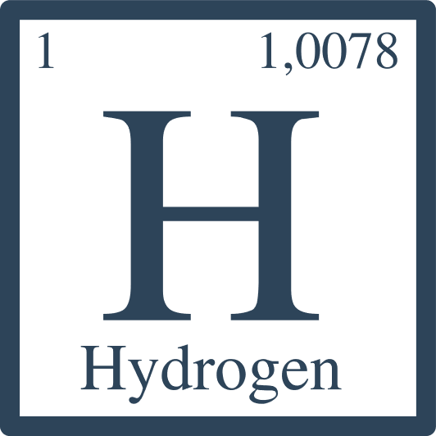


Power-to-X
Funded by the European Union. Views and opinions expresse are however those of the author(s) only and do not necessarily reflect those of the European Union or the European Education and Culture Executive Agency (EACEA). Neither the European Union nor EACEA can be held responsible for them.
This document has been created as part of the wider T-shore project, co-funded through the European Union’s ERASMUS+ programme.

Slide 2

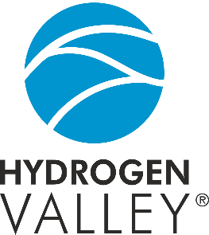


Document Information
Document Author Partners: Skive College
Version no. | Date | Description of changes | Prepared by
01 | 14.03.2025 | New presentation created | Jens Høffner, Heidi Katrine Rosenberg
02 | 30.04.2025 | Adjusted and added context | Verner Johnson, Heidi Katrine Rosenberg, Dennis Nørbjerg
Copyright
This document was developed under the T-shore project, coordinated by Skilliant. © 2024 – Skilliant. All rights reserved. Licensed to the European Education and Culture Executive Agency (EACEA) under conditions.

Slide 3
Aims and Objectives of Intro to Power-To-X theory
Main Aim
The purpose of this theory material is to provide an introduction to the technical knowledge related to Power-To-X. In addition, it contains elements of electrolysis and risks of using the various substances that can be used in Power-to-X, including carbon monoxide (CO), and CO2, hydrogen (H), as well as an understanding of safety aspects of using Power-to-X.

Slide 4
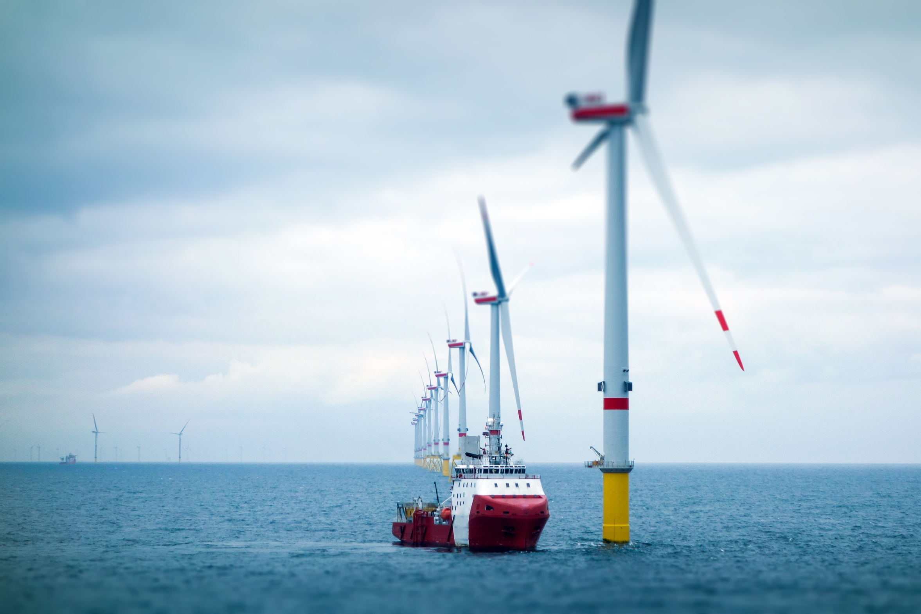
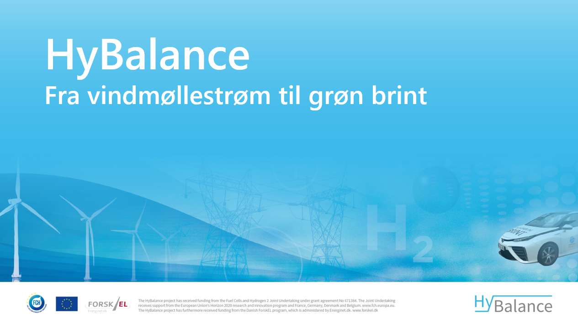
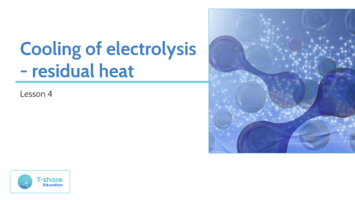
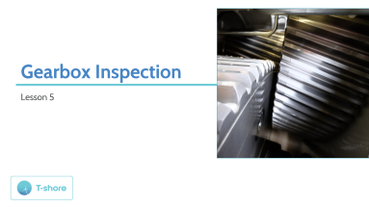
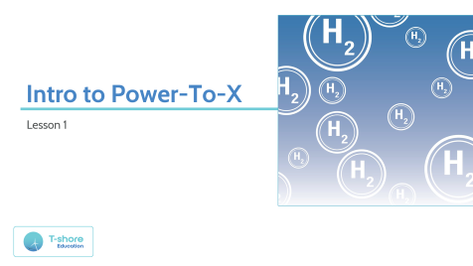

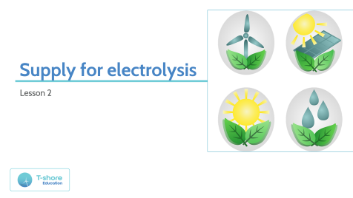
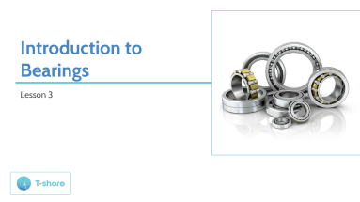

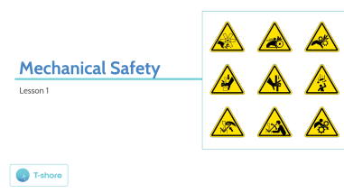
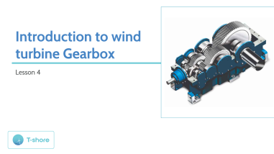
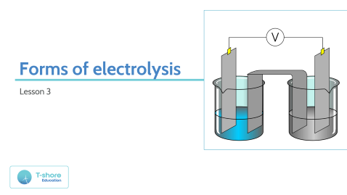


Content

Slide 5
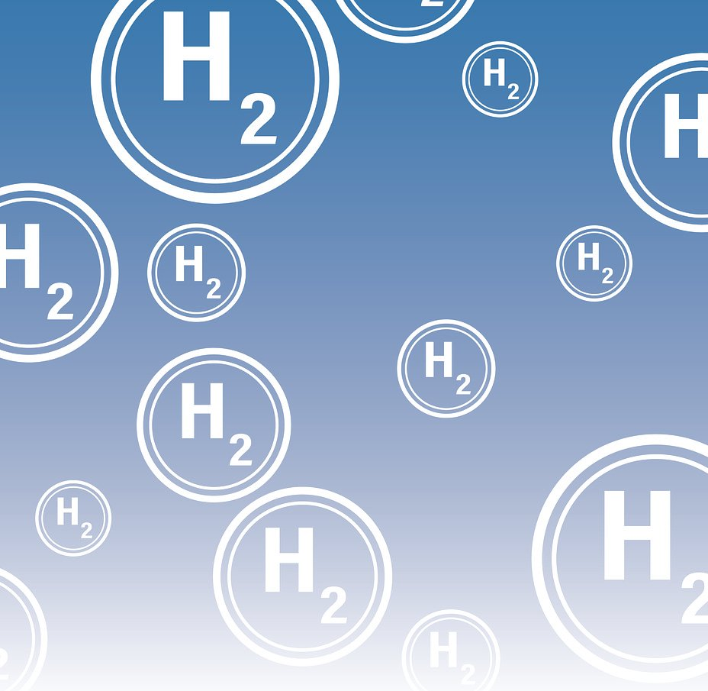
Intro to Power-To-X
Lesson 1

Slide 6

Power-To-X
Let's "dive" in:
Energy for something we don't know what is yet!
What is POWER to X?
Why POWER to X?
How to POWER to X?
What about ATEX?

Slide 7
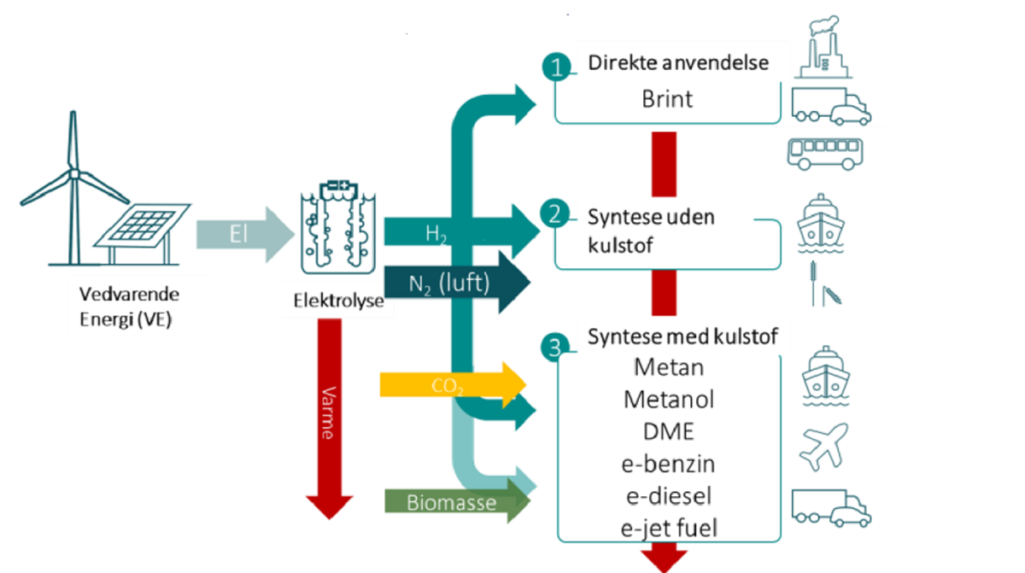
Power-To-X
The Danish Energy Agency assesses that PtX can become an important piece in Denmark's future energy system.
Power-to-X (PtX) covers a number of technologies, all of which are based on the fact that electricity is used to produce hydrogen.
In Denmark, they talk about Power-to-X, while abroad they call it green hydrogen or: Electrofuels or E-fuels.
Both concepts describe the process by which electricity and water are converted into green hydrogen through electrolysis.
The hydrogen can be used directly in e.g. trucks, ferries or industry, but it can also be further converted into other fuels.

Slide 8
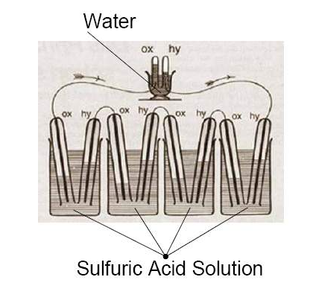
The history of Power-to-X
The story behind the development of Power-to-X from the first electrolysis experiments to the first Power-to-X plants in Denmark and the future for Power-to-X.
- Electrolysis As far back as 1839

Slide 9
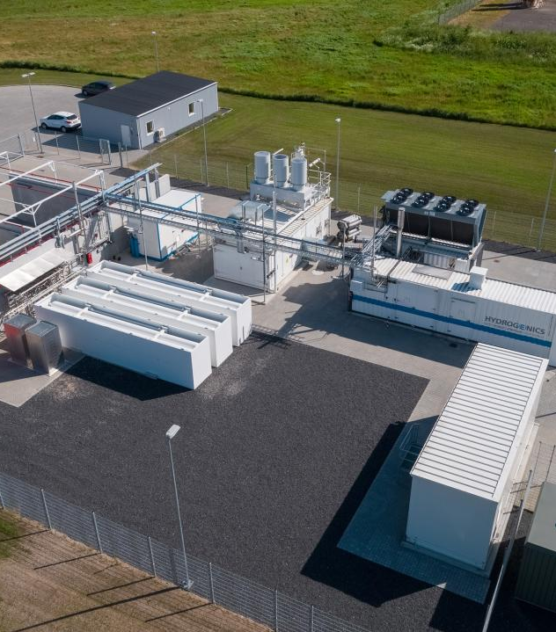
What can we learn from Denmark's first Power-to-X factory?
The HyBalance Project in Hobro
The demonstration plant produces hydrogen via PEM electrolysis using electricity and water
The plant will continue producing hydrogen for many years to come
Production and Technology
Since mid-2018, 120,000 kg of hydrogen has been produced (as of 1 September 2020)
Hydrogen enables greater capacity for storing electricity
Electrolysis technology is well-known, but here applied on a large scale
Large-scale storage of surplus wind power makes wind energy more economically attractive
Contribution to the Power Grid
The plant demonstrates how hydrogen production can help balance the electricity grid
HyBalance is approved by Energinet (the Danish supply grid) to participate in all electricity markets
Provides system services to help maintain balance in the power grid

Slide 10
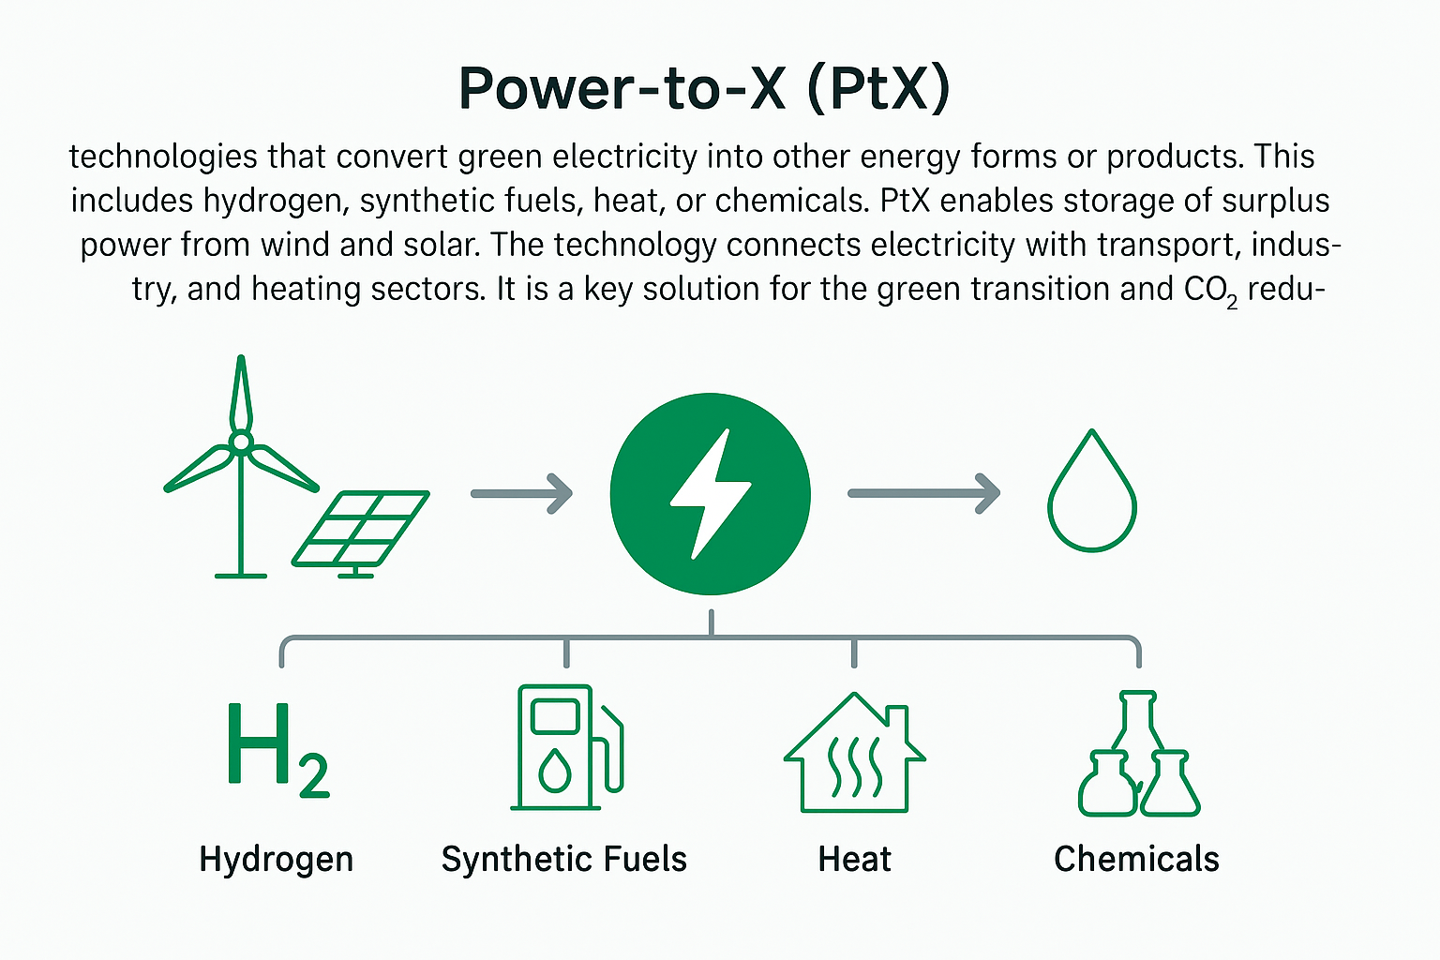
What is Power-to-X?

Slide 11
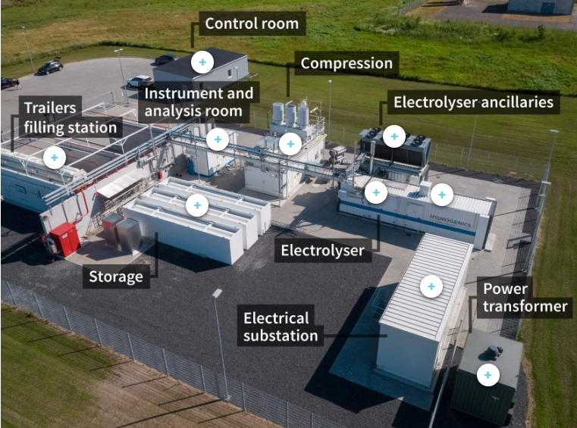
Power-to-X system
Power-to-X systems typically consist of several key components that work together to convert electricity into other energy carriers or fuels. The main components of such a system include the elements in the picture.
Do you know them?

Slide 12

Supply for electrolysis
Lesson 2

Slide 13
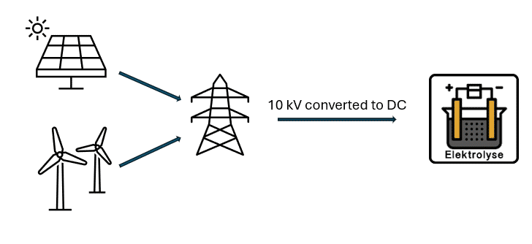
The energy supply for the Power-to-X process
Power-to-X Energy Supply
Requires stable and large electricity supply for electrolysis
Typically powered by renewable energy (wind, solar)
Ensures green and sustainable fuel production
Backup and Stability
Can use grid electricity as backup during low renewable output
Energy storage systems help balance supply and ensure stable operation

Slide 14
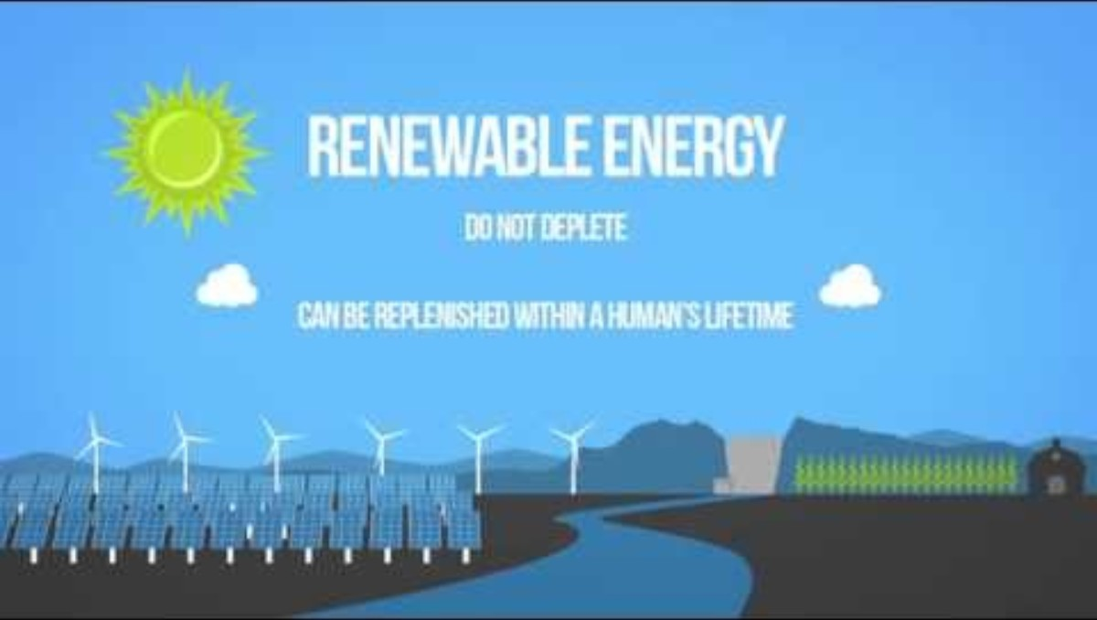
Green renewable energy
The green renewable energy sources such as solar energy, wind power and hydropower, have in common that they emit minimal CO₂ compared to the fossil energy sources.
Learn more about renewable energy by watching the video →

Slide 15
Electricity grid
The electricity grid in Denmark
Green energy is connected to the electricity grid, which consists of transmission and distribution networks
Transmission network (electric highways):
  100 kV and above, owned by Energinet
  Enables import/export of power between regions and countries
  Transports power from production to consumption areas
  Distribution network (local electric roads)
    Below 100 kV, connecting consumers and transmission networks
    Connection point for local electricity generation (CHP, solar cells, wind turbines)

Slide 16
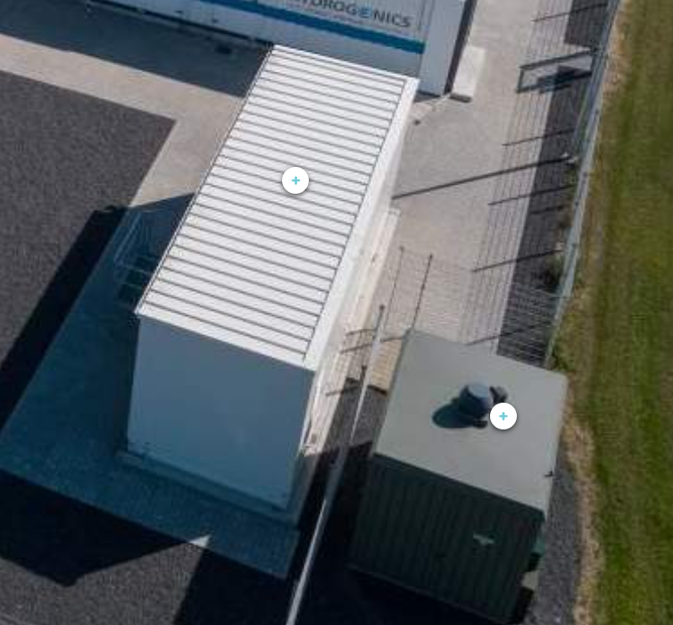
Transformer / Converter
Electrical substation
A Power-to-X facility is supplied with electricity through a transformer connected to the distribution grid. The transformer ensures that the electricity from the grid is adjusted to meet the facility's energy conversion requirements.
Power tranformer

Slide 17
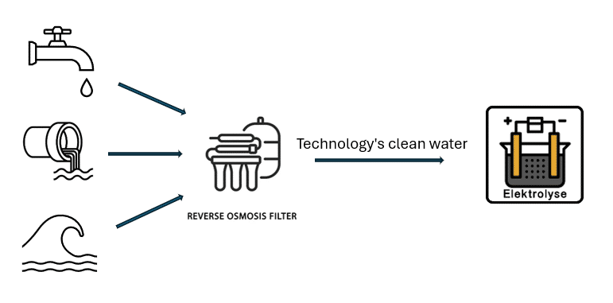
The water supply for the Power-to-X process

Slide 18
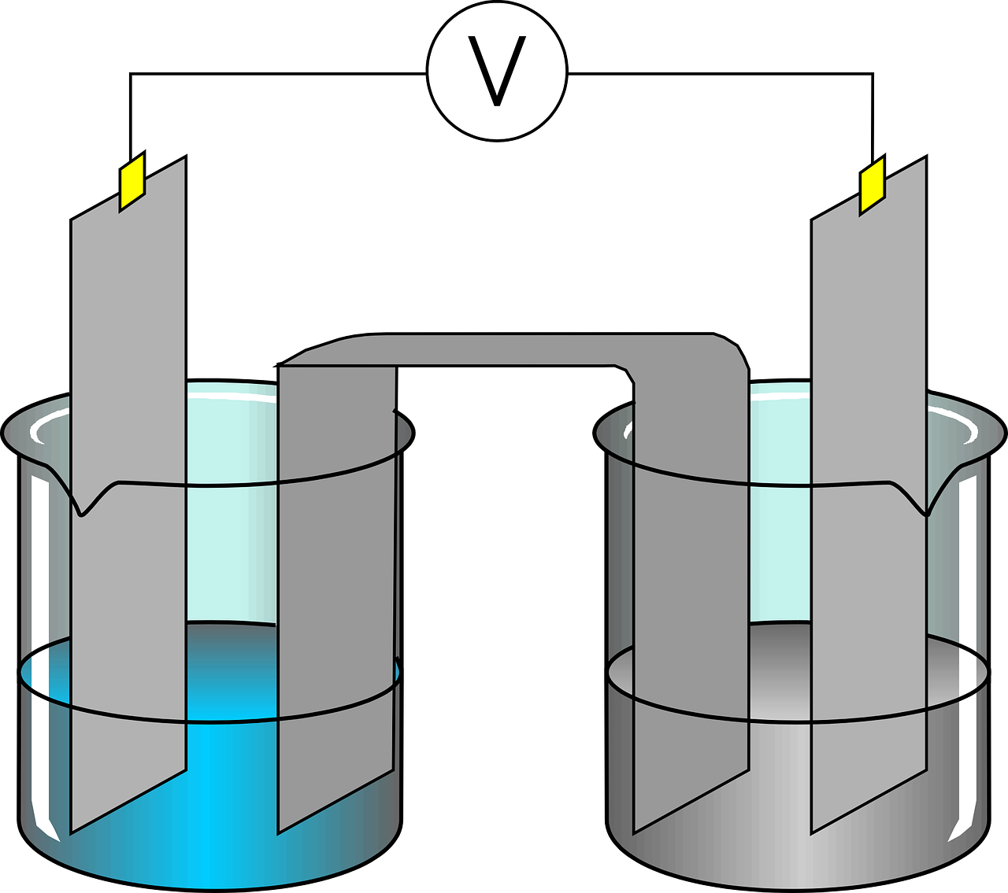
Forms of electrolysis
Lesson 3

Slide 19
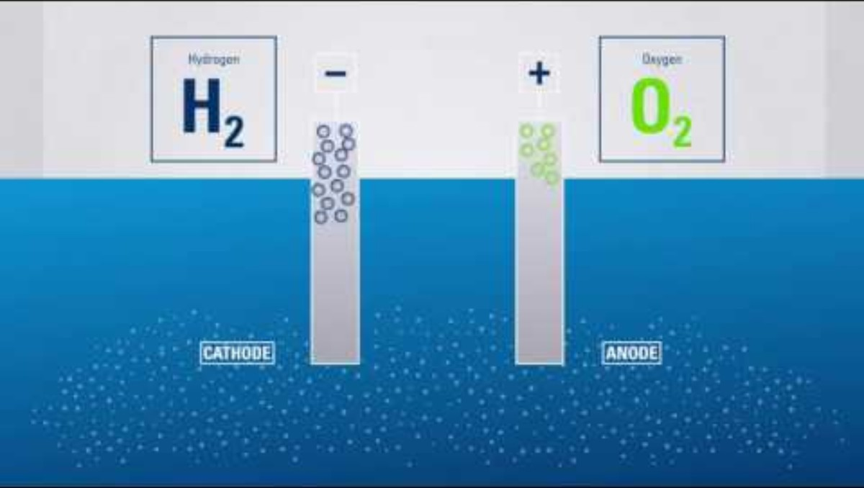
What is Electrolysis and Its Types?
Electrolysis uses electricity to drive non-spontaneous chemical reactions
Splits compounds into elements in an electrolytic cell
Uses an electrolyte and two electrodes: cathode (–) and anode (+)
Commonly splits water into hydrogen (H₂) and oxygen (O₂)
Core technology in Power-to-X for green hydrogen and synthetic fuels

Slide 20
Types of Electrolysis
Alkaline Electrolysis (AEC): An electrolysis process that uses a liquid alkaline electrolyte (KOH or NaOH) and porous separators to separate hydrogen and oxygen. It is a well-established technology with relatively low costs.
PEM Electrolysis (Proton Exchange Membrane): An electrolysis method where a proton-conducting membrane acts as the electrolyte. It has high efficiency, fast response time, and is well-suited for integration with renewable energy. (e.g. this technology is used in Hybalance in Hobro and at Greenlab Skive)
SOEC Electrolysis (Solid Oxide Electrolysis Cell): A high-temperature electrolysis method that uses a ceramic solid oxide electrolyte to achieve very high efficiency. It can utilise excess heat from industrial processes.

Slide 21
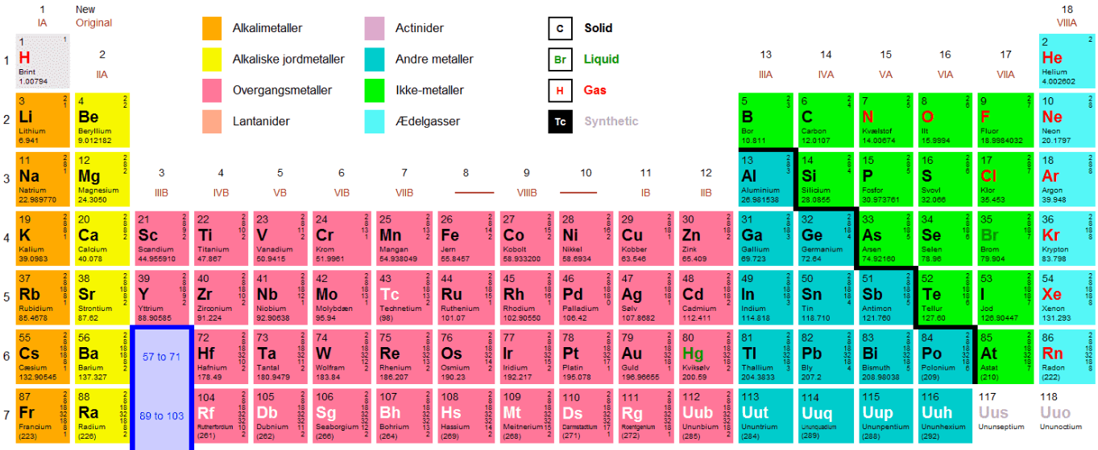
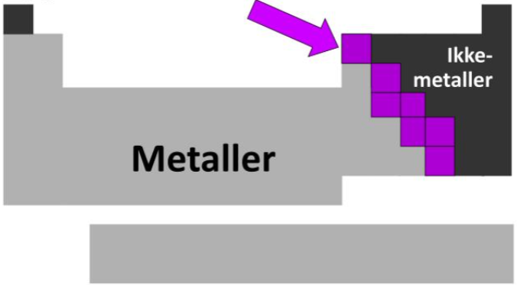
Universe “Building blocks” - Elements
118 Different elements.
94 (98) Naturally occurring.
24 (20) Artificially produced.
Semiconductor.

Slide 22
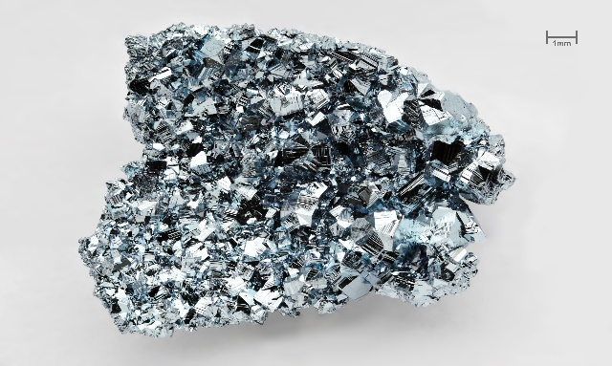
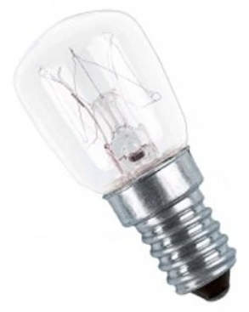
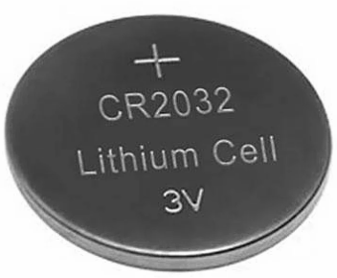
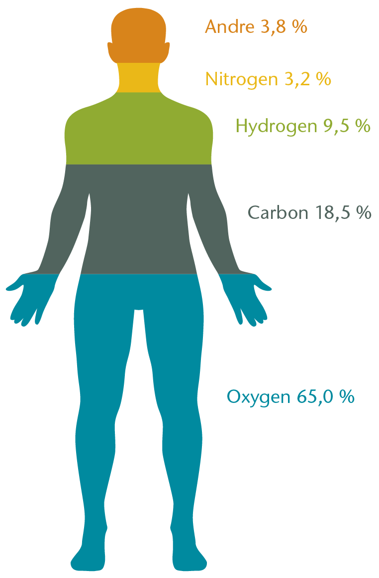

Universe “Building blocks” - Elements
Osmium
Element number 1, Hydrogen is the lightest.
Element number 76, Osmium is the heaviest.
The company name OSRAM (1906) is formed by: OSmium and WolfRAM (element no. 74)
Element number 3, Lithium (Li), is best known as an ingredient in batteries.
Lithium is also used in psychiatry to treat mental disorders.
Humans are made up of 28 elements.
An average smartphone contains about 30 different elements, of which 0.03 grams is element number 79: Gold (Au).
Element number 87, Francium (Fr), is the rarest element on Earth.
Francium is also highly radioactive, but decays as quickly as it is formed.
It is believed that no more than a few 100 grams exist at a time at any given time.

Slide 23

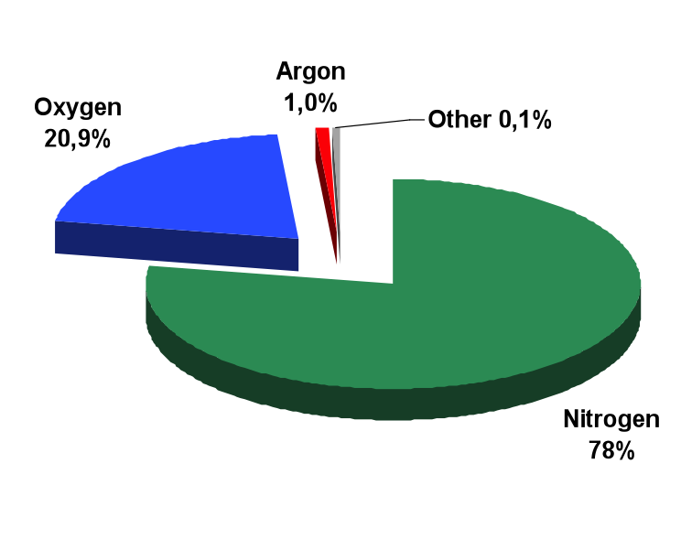
Universe “Building blocks” – In the atmosphere

Slide 24
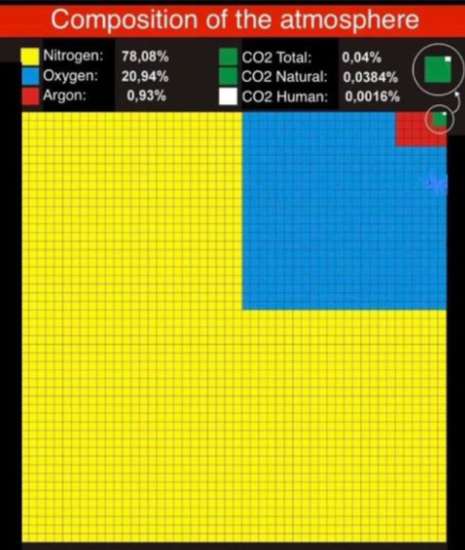
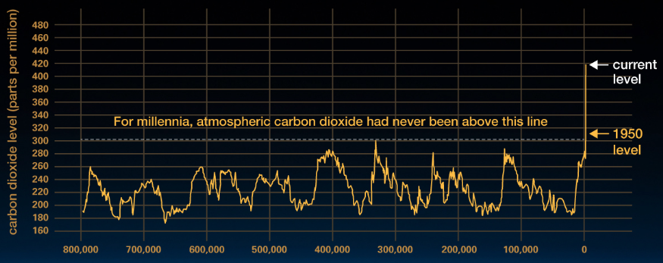


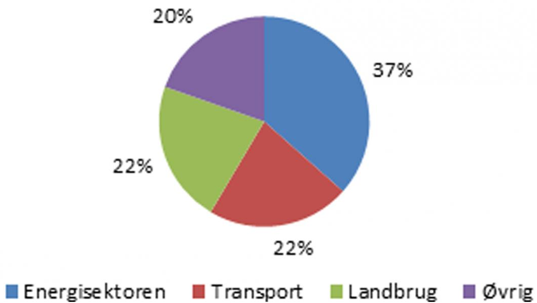
CO2 in the atmosphere !
The quantity
against
The concentration
CO2 is the chemical name for carbon dioxide, which is also called carbon dioxide.
The chemical name CO2 indicates that carbon dioxide consists of one carbon atom
and two oxygen atoms.
So CO2 is not an element, but a mixture of different substances!

Slide 25
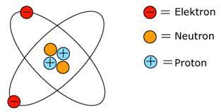

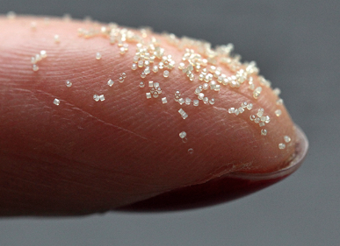
Atomets struktur
An ATOM is the smallest unit of an element.
Both the Protons and the Electrons are electrically charged.
An electron and a proton have an equal charge, but the charges are opposite.
The electrical charge of electrons is negative and that of protons is positive.
Since the atoms are electrically neutral outwardly, there must be an equal number of electrons and protons in each atom.
1 kilometre
atomic nuclei
Electron

Slide 26
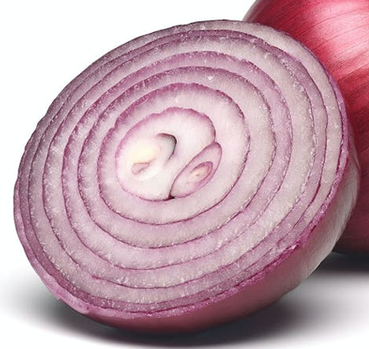
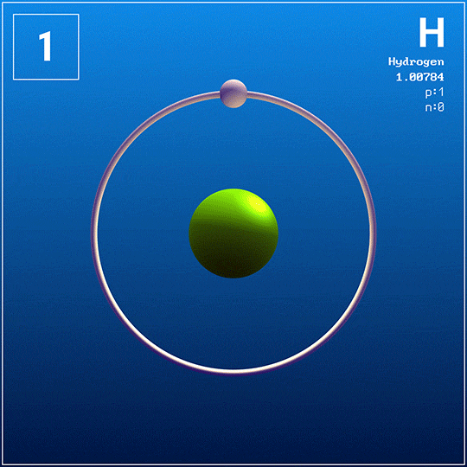
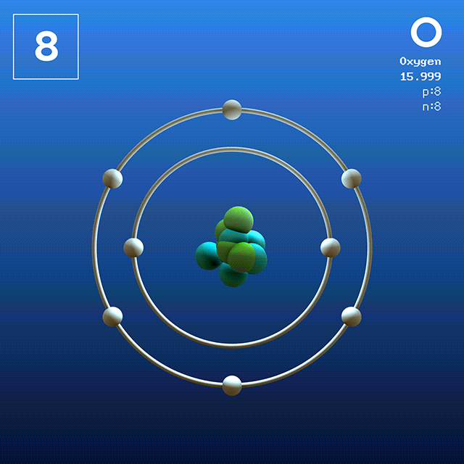
Atomets struktur
The atom can have up to 7 electron shells around the nucleus.
There can be from 1 to 32 electrons in the shells
1. Up to 2 electrons.
2. up to 8
3. up to 18
4th to 7th up to 32
The outermost electrons in the shells are the ones that
binds atoms together to form molecules.

Slide 27
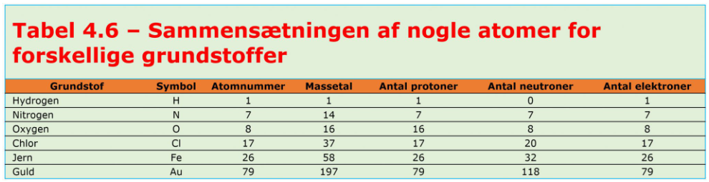
Atomets struktur
Atom vs molecule An atom is the smallest unit of an element. All atoms in a single element contain the same number of protons. Atoms cannot be further divided using any chemical method. In contrast, a molecule is the unit of a pure substance. A molecule is made up of more than one atom.

Slide 28
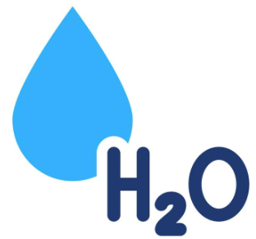

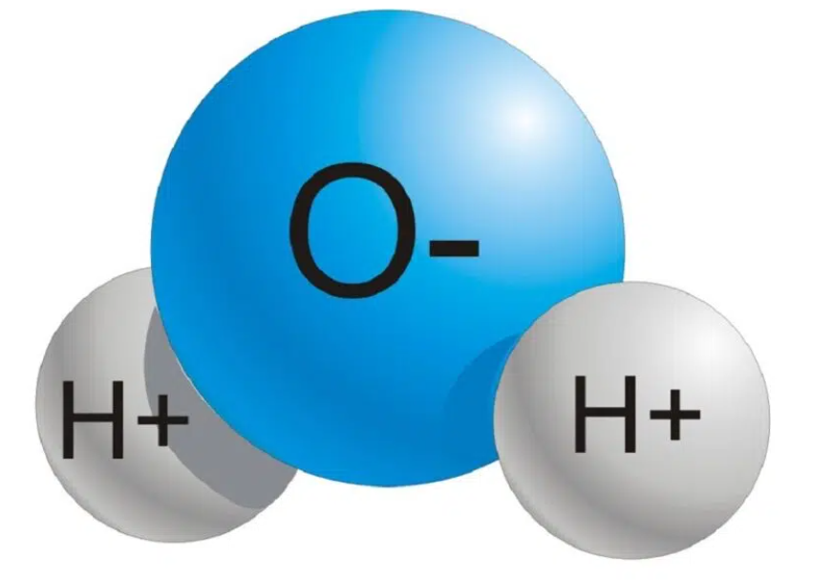
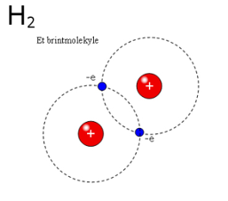
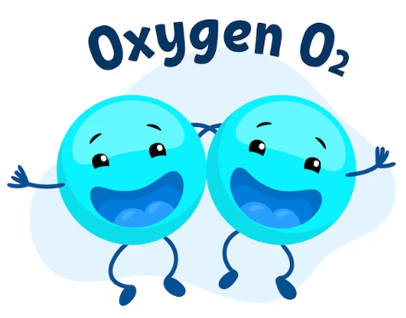
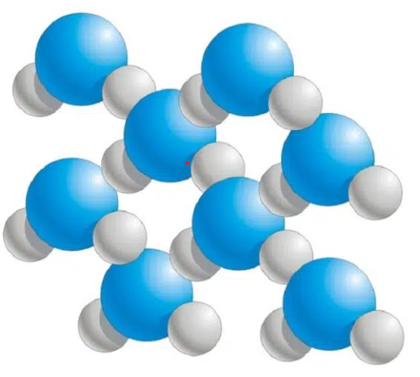
Electrolysis
Water molecule
Oxygen molecule
Brint-molecule

Slide 29

Cooling of electrolysis - residual heat
Lesson 4

Slide 30
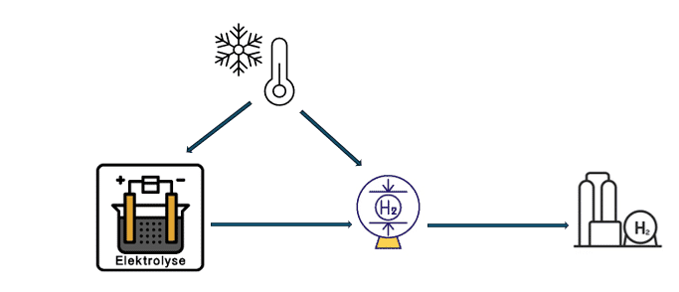
Cooling in Electrolysis and Hydrogen Compression Systems
Electrolysis systems and hydrogen compression systems require effective cooling to maintain optimal operation, prevent overheating, and ensure the longevity of the equipment. Cooling is critical because both the electrolysis process and the hydrogen compression generate significant amounts of heat, which must be removed to avoid thermal stress on the components.

Slide 31
Cooling in Electrolysis and Hydrogen Compression Systems
Electrolysis systems convert electricity and water into hydrogen and oxygen through an electrolytic process that produces heat during energy conversion. To regulate the temperature and maintain an efficient electrochemical reaction, various cooling strategies are employed:
Internal Liquid Cooling
External Heat Exchanger
Active Temperature Control:
Regulate temperature!
Awoid HEAT.

Slide 32
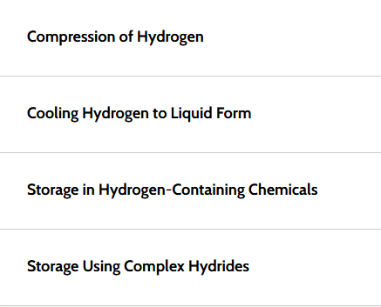
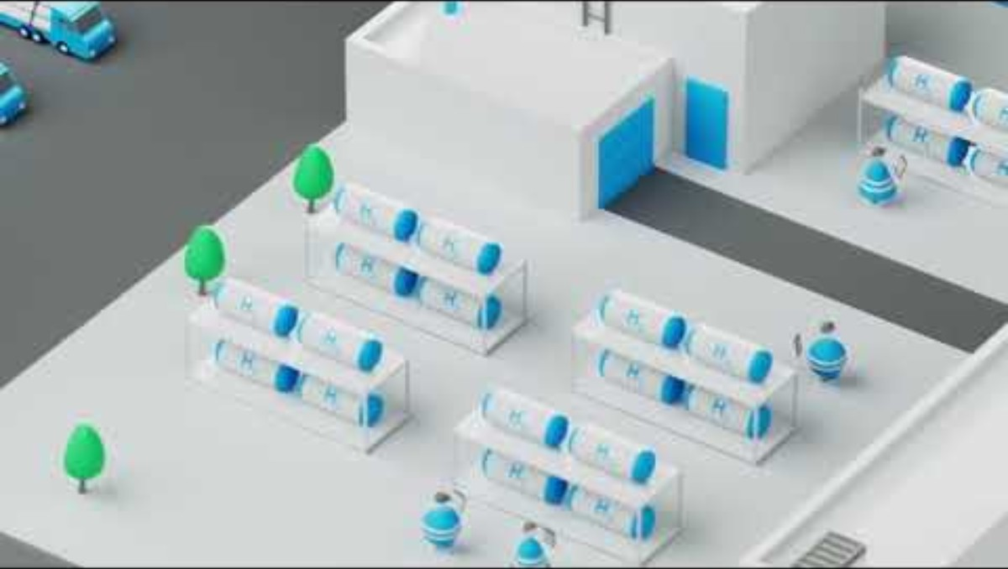
Storage of Hydrogen (H₂)
In order to utilise hydrogen's energy for later use, it is necessary to store the gas in an efficient manner. One of the biggest challenges in storing hydrogen is its very low mass density. This means that hydrogen in gas form requires large volumes to store sufficient amounts of energy. To make it possible to store hydrogen efficiently, several methods are used.

Slide 33

The products of electrolysis
Lesson 5

Slide 34
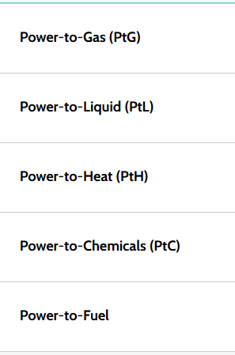
Products of Power-To-X
Power-To-X is an umbrella term for a set of technologies that enable the conversion of electrical energy, particularly from renewable sources, into various forms of energy carriers, fuels, or chemicals.
The Importance of Energy Density in Power-To-X Product Development

Slide 35
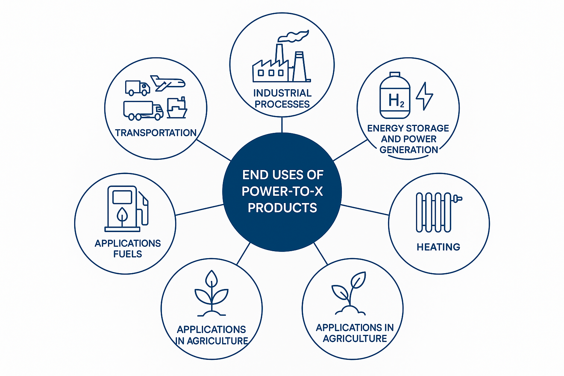
Typical End-Users of Power-to-X Products
Power-to-X products such as hydrogen, methanol, and synthetic fuels are essential components in the transition to sustainable energy systems.

Slide 36
Technological and Economic Considerations
Cost Competitiveness
Green hydrogen and other Power-To-X products are currently more expensive than their fossil-based counterparts. Scaling up production and advancements in electrolysis, synthesis, and storage technologies are essential to reduce costs.
Infrastructure Development
Infrastructure for hydrogen transportation, refueling, and storage, as well as facilities for synthesising and handling methanol and e-fuels, needs to be expanded to support large-scale adoption.
Policy Support
Governments and regulatory bodies play a critical role in accelerating the adoption of Power-To-X products by providing subsidies, setting mandates for renewable fuels, and funding research and development.

Slide 37

Safety, laws, regulations, and standards
Lesson 6

Slide 38







What is EX atmosphere?

Slide 39


What is EX atmosphere?
Majsmel.
11 døde, 488 såret, flere med 80-90% forbrænding af kroppen.
Statisk elektricitet, rygning, scenelamper?????

Slide 40






What is EX atmosphere?
Nedre eksplosionsgrænse:
(LEL) lower explosiv limit.
Øvre eksplosionsgrænse:
(UEL) upper explosiv limit.

Slide 41
Laws and regulations
Directive of the European Parliament and of the Council: 2014/34/EU
BEK no. 590 of 26/06/2003 Executive Order on the Classification of Hazardous Areas
BEK no. 811 of 03/06/2022 Executive Order on Products for Use in a Potentially Explosive Atmosphere
BEK no. 478 of 10/06/2003 Executive Order on Work in Connection with Explosive Atmospheres
BEK no. 1444 of 15/12/2010 Executive Order on Technical Regulations for Gases
DS/EN 60079-14:2014: Explosive atmospheres - Construction, selection and construction of electrical installations
DS/EN 60079-17:2014: Explosive atmospheres - inspection and maintenance of electrical installations
The Danish Safety Technology Authority: from 1 Dec. 2018, responsibility for the control of products covered by the 2014/34/EU directive
The Danish Working Environment Authority: Guidelines C.0.9 on work in connection with explosive atmospheres
The Danish Emergency Management Agency: Guidance on the classification of explosive hazardous areas

Slide 42

Assignment

Slide 43




In areas with explosive gas atmospheres (zone 1 and zone 0), the connection of power conductors must not be made with connectors.
However, connectors may be used if the assembly is carried out in a certified pressure-proof enclosure (i.e. marked Ex d).
All other power conductors must be assembled in certified terminal boxes, which will typically be in increased safety (i.e. marked Ex e) and with light blue terminals.
For power conductors in areas with dust (zone 21 and zone 20), connectors may be used if the enclosure is certified as dust protected (i.e. marked Ex tb for zone 21 or Ex ta for zone 20).
Since you are not allowed to change certified CE marked products, it must therefore be stated in the manual that connectors may be used.
As a rule, the equipment will be prepared with terminals).

Slide 44







ATEX: Clothing
When working in an ATEX environment, clothing certified to EN 1149-3/5 must be worn to ensure that the clothing does not create static sparks, which can cause an explosion.

Slide 45


PtX employees' skills and training.
"Help wanted to put together the best profile"

Slide 46
Scenario - Visit to Power-to-x facility
Participants will learn to perform a proactive visual inspection of the different elements of a Power-to-x facility. A visit to a Power-to-x facility could be planned. If not possible, the module could be supplemented by a virtuel tour to a plant: Maade PtX – where the same learning sceanario will be performed (as in real life).
In the following slides, are information about HyBalance facility in Hobro, close to Hydrogen Valley.

Slide 47
HyBalance
From wind turbine power to green hydrogen

Slide 48

Groundbreaking ceremony for advanced hydrogen plant at Hobro
The hydrogen factory will convert wind energy to green hydrogen as part of the HyBalance project
The minister said: "Hydrogen is one of the technologies we will be investing in in the future. I am very pleased that Denmark is at the forefront with this plant. We are going to show that we can do something here. It's not just talk and big desk plans - it's something that comes out in the real world"

Slide 49
What is HyBalance?
HyBalance is a project that will demonstrate how hydrogen can be included in the energy system of the future
Conversion of wind turbine power via electrolysis of water to hydrogen
This allows wind turbine power to be stored when there is plenty of it
At the same time, the conversion can help to balance the electricity grid, which is essential to ensure stable voltage in the grid
Green hydrogen can be used in the transport sector and in industrial production.

Slide 50





The partners in the HyBalance project
Air Liquide, Copenhagen Hydrogen Network (CHN), Hydrogenics, Neas Energy, Hydrogen Valley, Ludwig-Bölkow-Systemtechnik
The project is budgeted at DKK 125 million. It is supported by the ForskEL programme, managed by Energinet.dk, and the EU's Fuel Cells and Hydrogen 2 Joint Undertaking.

Slide 51
Background: The EU's objectives and challenges
The EU is committed to a long-term climate policy that prioritises a stable and independent energy supply - based on non-fossil energy sources
The share of renewable energy will increase. Therefore, it is crucial to be able to store renewable energy and use it in sectors that have hitherto been dependent on fossil fuels – including transport
Hydrogen is considered one of the keys to solving that challenge.

Slide 52
Why has Denmark been selected for HyBalance?
Denmark is one of the countries in the EU with the most ambitious energy policy
In 2012, a parliamentary majority entered into the energy agreement, which states that
50% of Denmark's electricity consumption must be covered through wind power by 2020
The use of fossil fuels in heating and electricity must end by 2035
Denmark must be independent of fossil fuels by 2050
Denmark has a lot of wind energy
Denmark has know-how in hydrogen and fuel cell technologies
Denmark is the first and only country in the world to have a nationwide network of hydrogen filling stations
Hydrogen cars are exempt from taxes until 2019

Slide 53

Wind turbine power will be an important source of energy
  The supply from renewable energy sources is becoming more important, and the share of green electricity from wind turbines in particular is increasing

Slide 54

The necessity of balance in the electricity grid
Wind energy is fluctuating – the electricity grid requires a stable supply
In some periods, we can produce more electricity from wind turbines than the grid can absorb
We can export surplus electricity production – or bring wind turbines to a standstill
Or we can store surplus wind energy by converting it into hydrogen
HyBalance will develop business models for when it is worthwhile to convert electricity to hydrogen

Slide 55

Storage and storage of renewable energy
By storing wind turbine energy as hydrogen, we can make optimal use of the wind turbine energy
And we get a product – green hydrogen – that can be used in industry and in the transport sector.

Slide 56

Hydrogen in the transport sector
Hydrogen cars are on the rise
Most major car manufacturers have hydrogen cars on their program
Hydrogen cars only emit water, are quick to refuel and have a large driving radius compared to electric cars
Denmark has 10 hydrogen filling stations – and plans for more filling stations

Slide 57

The HyBalance process

Slide 58

PEM Electrolysis
PEM (Proton Exchange Membrane) electrolysis is characterised by high efficiency (hydrogen per kWh of electricity)
The technology is flexible (short start-up time and no problems with frequent starts/stops)
This makes PEM very suitable for balancing fluctuating energy sources
HyBalance to validate how dynamic PEM electrolysis is

Slide 59
HyBalance timetable
In 2016, construction of the hydrogen plant begins
From the end of 2017, the plant is expected to be able to deliver hydrogen

Slide 60
Potential: Supply to the transport sector
The plant will be able to produce 230 Nm³/h hydrogen
It will be able to keep 1000 hydrogen cars on the roads
Also production for hydrogen buses and hydrogen forklifts
There is a need for more hydrogen cars to be rolled out
There is a need for more filling stations that can service hydrogen cars and meet the need

Slide 61
Potential: Supplementing energy to the natural gas grid
Denmark has a well-established natural gas network
CO2 (from biogas) and hydrogen can be fused under high pressure - and can thereby form artificial methane
The methane can be fed directly into the natural gas grid

Slide 62

Potential: Storage of larger amounts of hydrogen
  In North Jutland, close to Hobro, there are salt caverns that can eventually be used to store hydrogen and biogas on a larger scale

Slide 63

Summary: HyBalance promotes green transition
  HyBalance converts wind turbine power to hydrogen
  The hydrogen is sold to industry and the transport sector
  HyBalance uncovers business models for when it is worthwhile to convert wind turbine power to hydrogen
  HyBalance validates PEM technology
  HyBalance uncovers how hydrogen can contribute to making Denmark free of fossil energy sources

Slide 64
Read more on www.hybalance.eu

Slide 65



tshore.eu@gmail.com
t-shore.eu

